Slide 1
OTD 503
Librarian session 1:
the knowledge economy
CC-BY 4.0 License 2024 Devon Olson, MLIS, AHIP
Library Resources

Slide 2
Librarian sessions
knowledge economy
government documents
beyond the article
disseminating results
information literacy
CC-BY 4.0 License 2024 Devon Olson, MLIS, AHIP

Slide 3
today:
the knowledge economy
SQ3R
Mini lecture
Re-use activity
Mini lecture
Journal rating activity
CC-BY 4.0 License 2024 Devon Olson, MLIS, AHIP

Slide 4
learning objectives
analyze differences between creative commons and traditional copyright
evaluate and reflect on the concept of the "knowledge economy" within the context of evidence-based OT practice
CC-BY 4.0 License 2024 Devon Olson, MLIS, AHIP

Slide 5
Activity: Reading > the SQ3R method
Larivière, V., Haustein, S., Mongeon, P.. 2015. The Oligopoly of Academic Publishers in the Digital Era. PLOS. https://doi.org/10.1371/journal.pone.0127502
shared doc per section – CR and GF
https://tinyurl.com/2p8canm3
Survey – Look over main headings
Question – What is the main point?
Read – Search for answers to your question
Recite - What have you learned?
Review
CC-BY 4.0 License 2024 Devon Olson, MLIS, AHIP

Slide 6
Now, a brief history* of Western Academic Publishing
*this history will be highly Eurocentric/Western, mostly because academic publishing is also a very Western system
Remember “epistemology”= the study of ways of knowing
“epistemicide” = the practice of killing ways of knowing:
“…what is generally understood as knowledge in the universities of our world represents a very small proportion of the global treasury of knowledge. University knowledge systems in nearly every part of the world are derivations of the Western canon, the knowledge system created some 500 to 550 years ago in Europe by white male scientists…”
>>We must ask “Who and what is missing?”
(see also Lijuan 2024, Hall & Tanden 2017, Santos 2014)
CC-BY 4.0 License 2024 Devon Olson, MLIS, AHIP

Slide 7
An aside:
from : Lijuan Xu (22 Jan 2024): Information Literacy through the Lens of Epistemic Justice: Centering the Missing and Unheard Voices of Marginalized Groups, New Review of Academic Librarianship, DOI: 10.1080/13614533.2024.2306366
“…“epistemic injustices” concern ‘what is categorized, constructed, and perceived as knowledge’ and ‘the distinct ways in which knowledge is disseminated’ (Khoo et al., 2020, p. 55).
Fricker (2007) suggests that epistemic injustices manifest in two distinct and intertwined forms:
testimonial injustice that disadvantages and denies certain groups of peoples’ capacities to know and create knowledge, and hermeneutical injustice that prevents these groups as well as the society from making sense of their experiences, due to the gaps in the collective knowledge pool.
Hermeneutical injustice can also occur when resources are insufficient, for example, when only myths or stereotypes are available (Croce et al., 2021, p. 41).

Slide 8
First, some global historical context:
in the 16th century:
“The four epistemicides”
the conquest of Al-Andalus, the expulsion of Muslims and Jews from Europe,
the conquest of the Indigenous Peoples of the Americas started by the Spanish, continued by the French and the English
creation of the slave trade that resulted in millions being killed in Africa and at sea
the killing of millions of Indo-European women, mostly through burning at the stake as witches
“These conquests transformed Europe from being at the periphery of an earlier dominant Islamic centre of intellectual power to being centre stage.” (Hall & Tanden 2017)
CC-BY 4.0 License 2024 Devon Olson, MLIS, AHIP

Slide 9
November 1660: the western world’s first “learned society” was founded by royal charter by King Charles II of England.
https://pictures.royalsociety.org/image-rs-9673
CC-BY 4.0 License 2024 Devon Olson, MLIS, AHIP

Slide 10
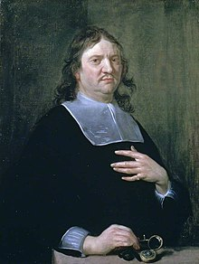
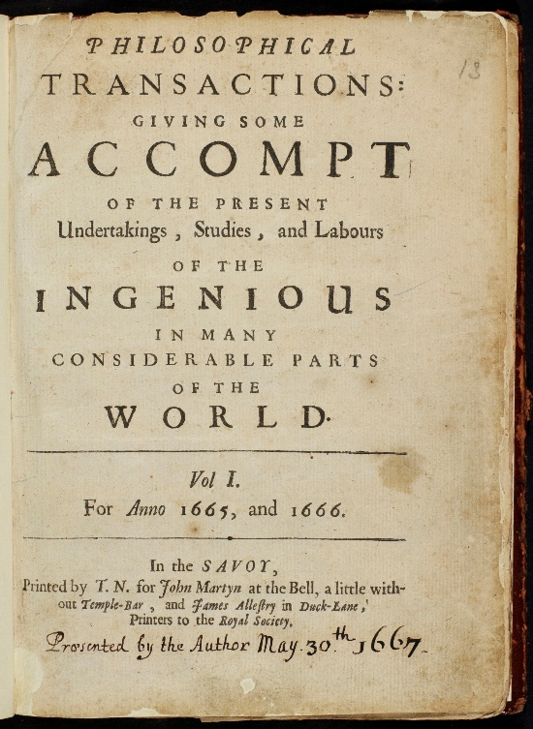
March 6 1665, Henry Oldenburg stapled together the “philosophical” treatises the Society had received and thus the first ever scholarly journal was created.*
https://pictures.royalsociety.org/image-rs-9673
https://upload.wikimedia.org/wikipedia/commons/4/42/Philosophical_Transactions_Volume_1_frontispiece.jpg
CC-BY 4.0 License 2024 Devon Olson, MLIS, AHIP
*this is a highly Eurocentric and unprovable claim

Slide 11
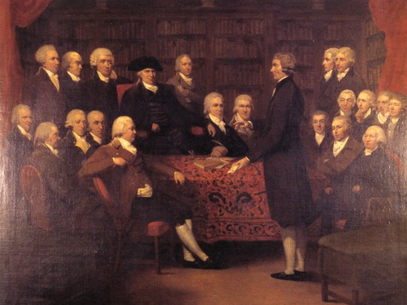
early scholars were
men
independently wealthy or privately sponsored
part of “societies” of learning
>>membership based on social standing
Image of Royal Society of Medicine members, founded 1773
https://www.rsm.ac.uk/about-us/history-of-the-rsm/
CC-BY 4.0 License 2024 Devon Olson, MLIS, AHIP

Slide 12
1700’s:
Advent of print culture in UK
Scholarly Prestige
Social standing
Lists of publications
CC-BY 4.0 License 2024 Devon Olson, MLIS, AHIP

Slide 13
Meanwhile,
1787: Copyright established within US Constitution
Article I, Section 8, Clause 8, “the Congress shall have power . . . to promote the progress of science and useful arts, by securing for limited times to authors and inventors the exclusive right to their respective writings and discoveries.”
CC-BY 4.0 License 2024 Devon Olson, MLIS, AHIP

Slide 14
Late 1800’s: US asserts its scholarly independence
University presses allow scholarly publishing to develop in US without private publishers’ industry
Early presses at Johns Hopkins, Chicago, and Cornell showed the young US’ commitment to graduate education
Altbach 1978
CC-BY 4.0 License 2024 Devon Olson, MLIS, AHIP

Slide 15
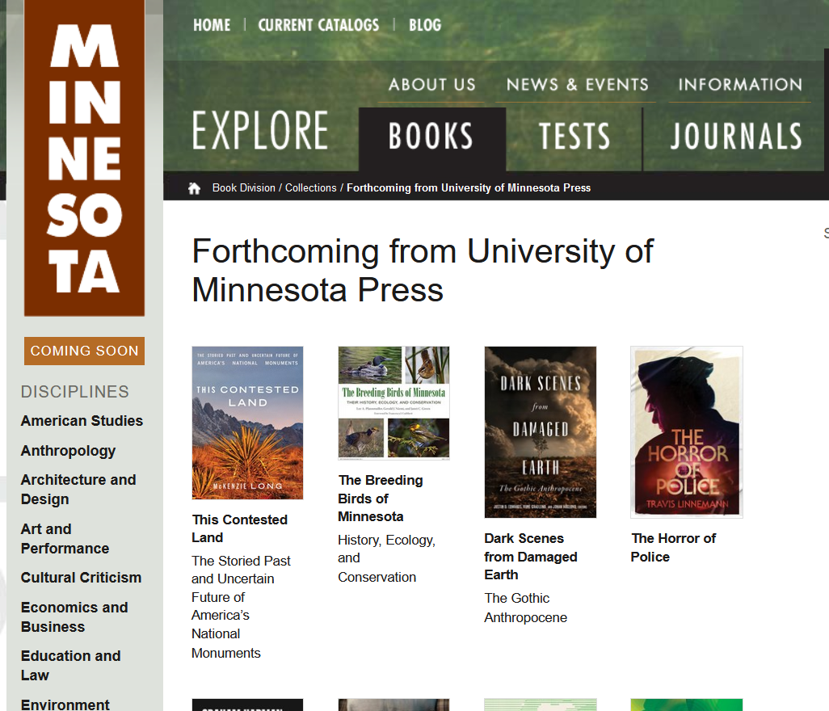
1960’s – 1970’s:
Golden age of university presses created by unprecedented federal funding
Altbach 1978
1964:
Journal rankings and Impact Factor (IF) metrics introduced by the Science Citation Index
Future 2019
CC-BY 4.0 License 2024 Devon Olson, MLIS, AHIP

Slide 16
1970’s:
Wider availability of databases meant shift to counting citations rather than publications
Scholarly Prestige
Social standing
Lists of publications
Lists of citations
CC-BY 4.0 License 2024 Devon Olson, MLIS, AHIP

Slide 17
Global context: 1970s
Scholarly infrastructure in non-western countries was still stymied by colonialism
close to half of the books published in India were in English, despite only 2% of the population of the Indian population being literate in English (Altbach 1978)
Majority of the publishing houses operating in non-western countries are either
A) local firms of foreign publishing firms, often hailing from the countries which previously colonized those non-western countries. For example, British Oxford University Press operating in Africa
B) government-funded efforts focused on elementary-level textbooks or examination forms, not scholarly publications
Altbach 1978
CC-BY 4.0 License 2024 Devon Olson, MLIS, AHIP

Slide 18
1976: Copyright Act revised in Title 17 of the U.S. Code in Article 1, Section 8, Clause 8
protects “fixed” expressions of ideas, and guarantees the creator exclusive rights to
reproduce
distribute
perform
display
and produce derivatives
of the work
CC-BY 4.0 License 2024 Devon Olson, MLIS, AHIP

Slide 19
Copyright:
is automatic
But if you want to go to court later, you should register your copyright first
CC-BY 4.0 License 2024 Devon Olson, MLIS, AHIP

Slide 20
What is Fair Use?
A legal doctrine that promotes freedom of expression by permitting the unlicensed use of copyright-protected works in certain circumstances:
criticism,
comment
news reporting
teaching
scholarship
research
Section 107 of the Copyright Act
Copyright.gov: “More information on fair use”
CC-BY 4.0 License 2024 Devon Olson, MLIS, AHIP
https://www.google.com/url?sa=i&url=https%3A%2F%2Fwww.theverge.com%2F2012%2F1%2F26%2F2736010%2Fuk-photography-copyright-ruling&psig=AOvVaw05uVv0kDZBj8WIYCqC2uLh&ust=1644436345376000&source=images&cd=vfe&ved=0CAsQjRxqFwoTCOiHgv7w8PUCFQAAAAAdAAAAABAW

Slide 21
evaluating Fair Use:
Section 107 calls for consideration of the following four factors in evaluating a question of fair use:
Purpose and character of the use, including whether the use is of a commercial nature or is for nonprofit educational purposes
Nature of the copyrighted work
Amount and substantiality of the portion used in relation to the copyrighted work as a whole
Effect of the use upon the potential market for or value of the copyrighted work
Copyright.gov: “More information on fair use”
CC-BY 4.0 License 2024 Devon Olson, MLIS, AHIP

Slide 22
1980’s
New for-profit publishers moved in with a new focus:
detailed primary research papers
selling to institutions
the international market
“By 1950, it has been estimated that there were around 10,000 journals worldwide, and by 1980, that estimate grew to 62,000” (Fyfe 2017)
CC-BY 4.0 License 2024 Devon Olson, MLIS, AHIP

Slide 23
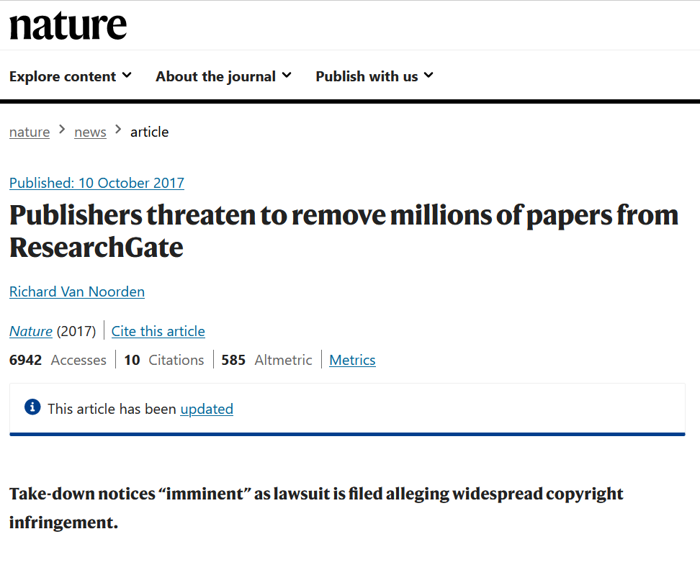
1990’s:
The Internet
CC-BY 4.0 License 2024 Devon Olson, MLIS, AHIP
Notes:
In 2017, one librarian did an informal poll and found that 24 of 31 libraries they contacted had canceled a “big-deal” subscription, with 79% of the cancellations taking place between 2015 and 2017

Slide 24
1990’s:
The Internet, aka,
a new commercial opportunity for publishers
Big-deals lock in subscribers to more titles than they’d subscribe to singly
Selling individual articles directly to readers
Offering additional paid-for-services: statistics, citations
Charging for text and data mining
CC-BY 4.0 License 2024 Devon Olson, MLIS, AHIP
Notes:
In 2017, one librarian did an informal poll and found that 24 of 31 libraries they contacted had canceled a “big-deal” subscription, with 79% of the cancellations taking place between 2015 and 2017

Slide 25
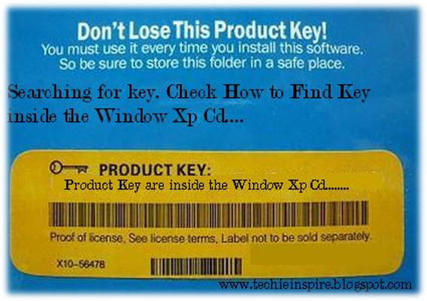
1998:
DRM! The Digital Millenium Copyright Act made it a crime to circumvent digital rights management (drm) technology.
CC-BY 4.0 License 2024 Devon Olson, MLIS, AHIP

Slide 26
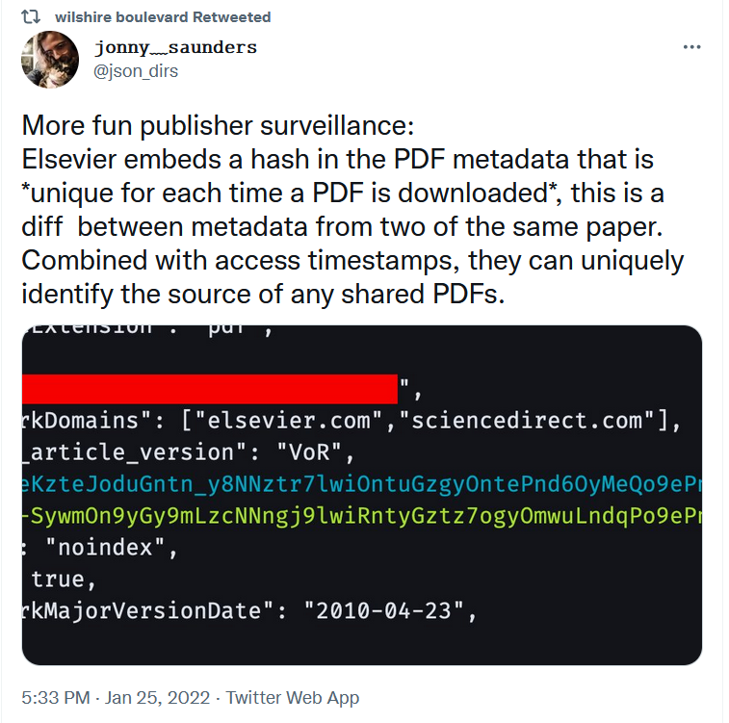
DRM in 2021:
CC-BY 4.0 License 2024 Devon Olson, MLIS, AHIP

Slide 27
also 1998:
https://sparcopen.org/
The Scholarly Publishing and Academic Resources Coalition
established a fund for Open Access Publishing
also known for its copyright addendum
(SPARC 2018)
CC-BY 4.0 License 2024 Devon Olson, MLIS, AHIP

Slide 28
2002:
https://en.unesco.org/
Coined the term:
“open educational resources”
at the Forum on the Impact of Open Courseware for Higher Education in Developing Countries
(Johnstone 2005)
Released a set of copyright licenses which allowed differing kinds of reuse, unlike traditional copyright.
CC-BY 4.0 License 2024 Devon Olson, MLIS, AHIP

Slide 29
Open access resources
licensed resources
CC-BY 4.0 License 2024 Devon Olson, MLIS, AHIP

Slide 30
open educational resources
allows authors to
allow users different kinds of reuse
CreativeCommons 2018
CC-BY 4.0 License 2024 Devon Olson, MLIS, AHIP
sparcopen.org

Slide 31
OA textbook w/a CC-BY license
CC-BY 4.0 License 2024 Devon Olson, MLIS, AHIP

Slide 32
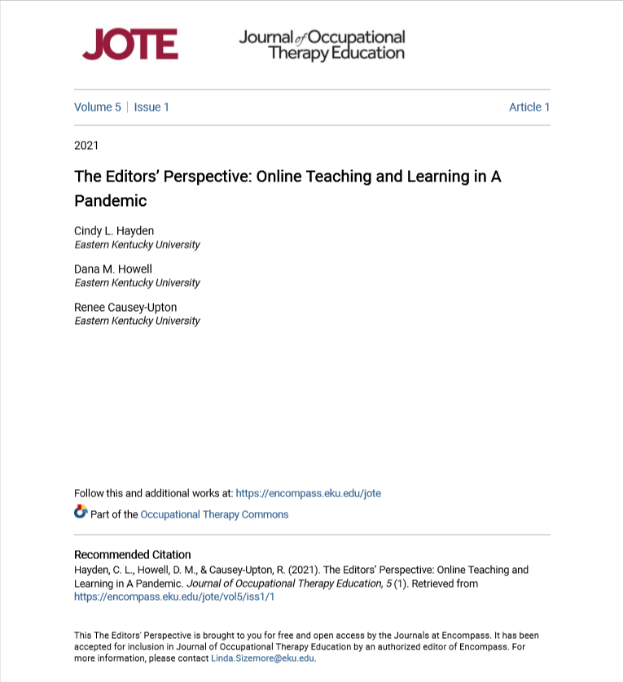
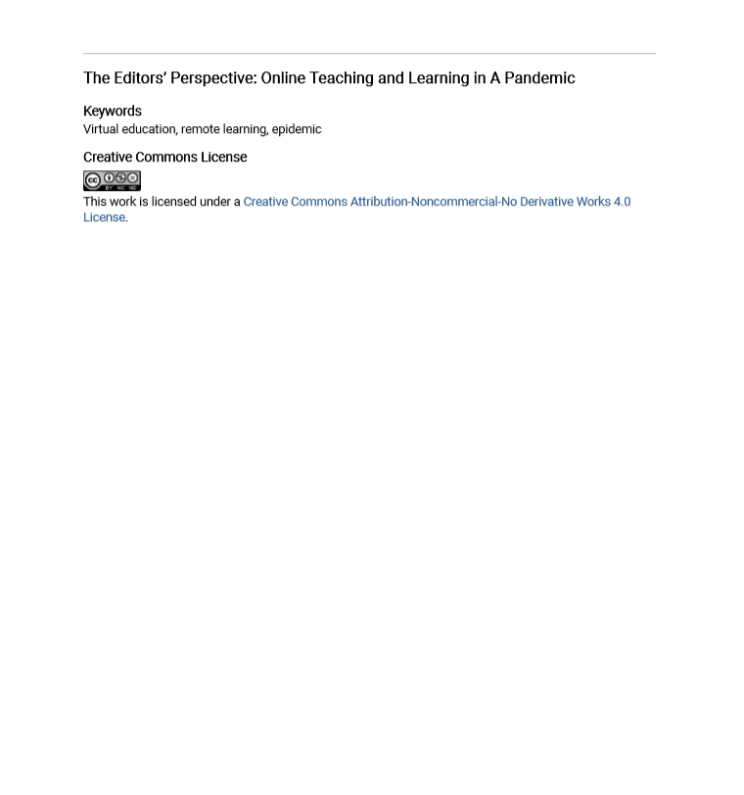
OA article w/a CC-NC-ND license
CC-BY 4.0 License 2024 Devon Olson, MLIS, AHIP

Slide 33
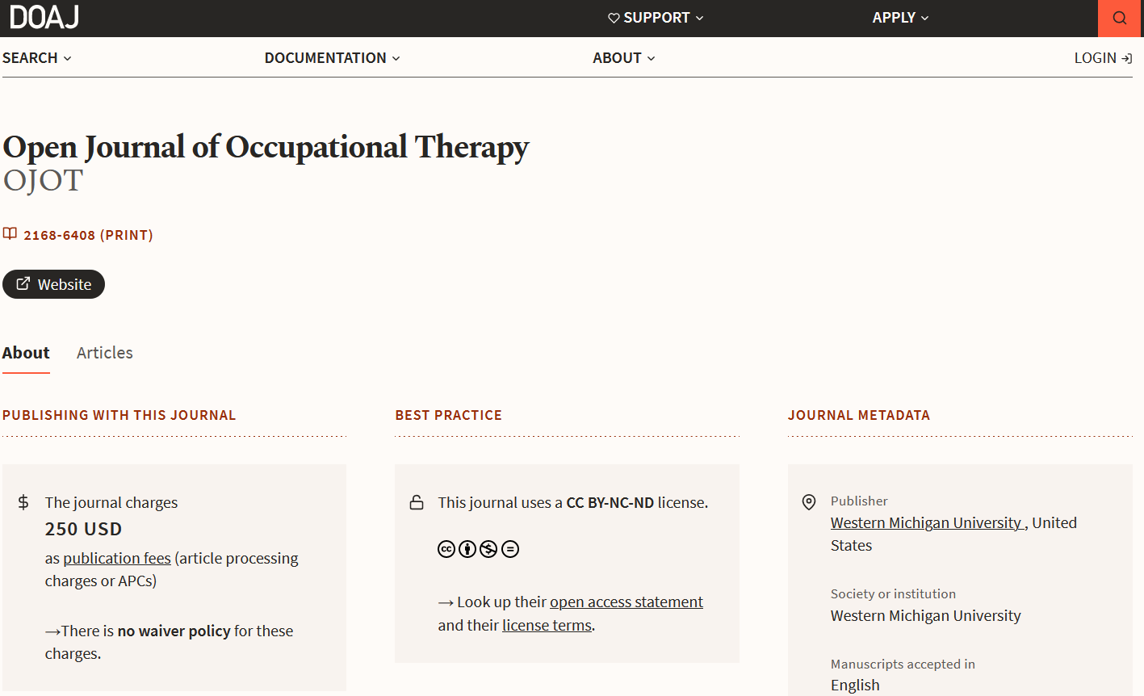
OA journal w/a CC-BY-NC-ND license
CC-BY 4.0 License 2024 Devon Olson, MLIS, AHIP

Slide 34
copyright law
creative commons exists
in dialogue with other legal structures
creative commons
UND IP Policy
CC-BY 4.0 License 2024 Devon Olson, MLIS, AHIP
Images: website: https://www.iconfinder.com/icons/532723/browser_content_internet_page_web_web_page_website_icon ; person: https://www.iconfinder.com/icons/403023/avatar_female_person_user_woman_young_icon

Slide 35
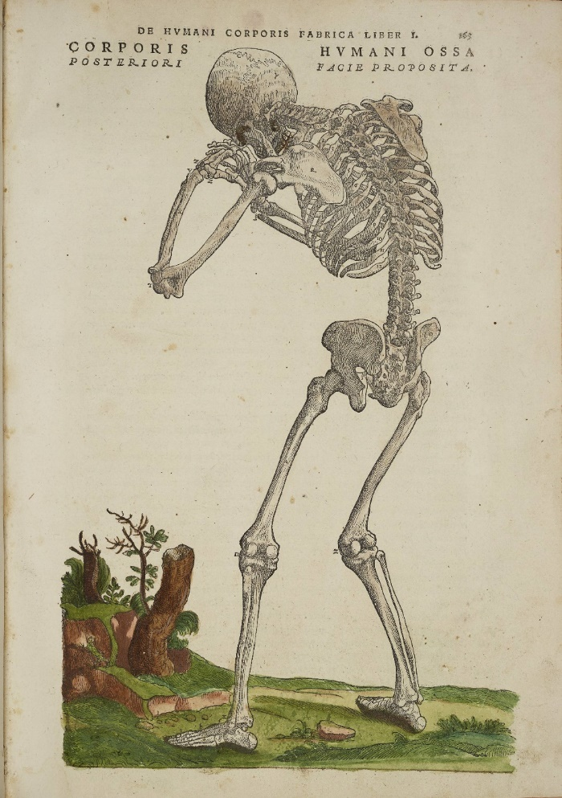
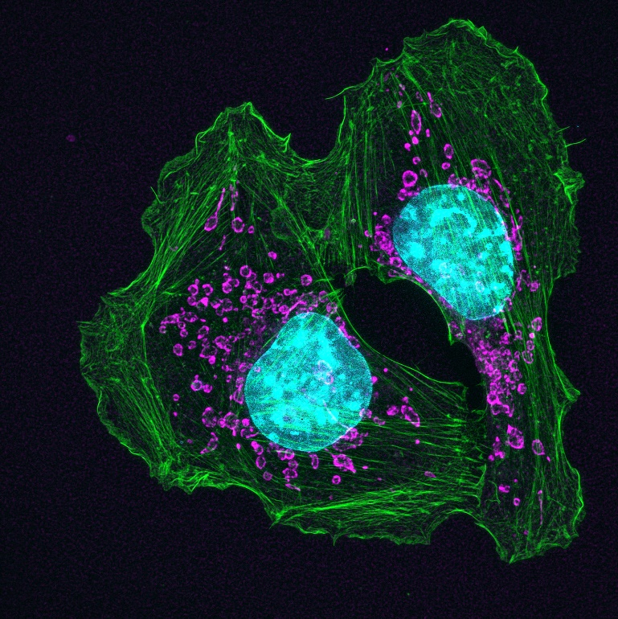
Some other possibilities:
There are resources that aren’t labeled “creative commons” or “open” that you can still use
Government resources are owned by the public
(NIH image gallery: https://www.flickr.com/photos/nihgov/26192443504/in/album-72157666320520263/ )
Items that are in the “public domain” are free of copyright (De Humani Corporis fabrica libri septum: https://www.flickr.com/photos/nihgov/26192443504/in/album-72157666320520263/ )
CC-BY 4.0 License 2024 Devon Olson, MLIS, AHIP
Images: book: https://www.iconfinder.com/icons/1741315/school_textbooks_textbooks_icon; licenses: sparcopen.org

Slide 36
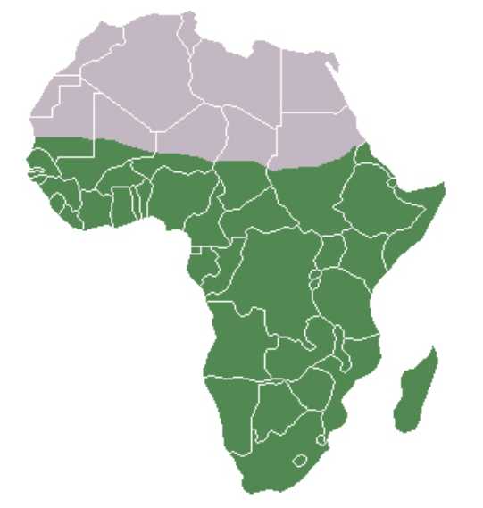
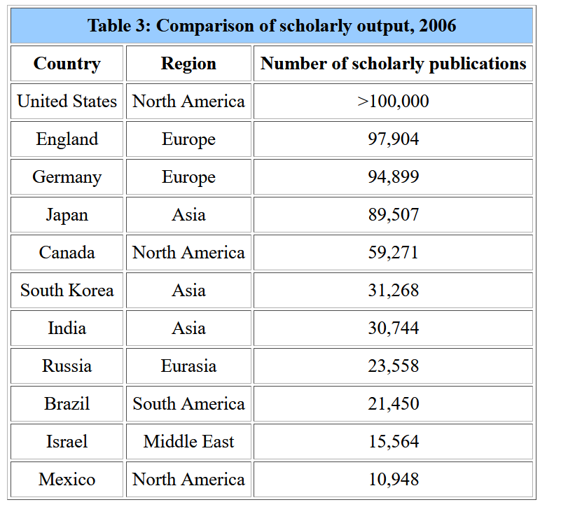
Global context: 2006
Low “scholarly output” in
Sub-Saharan Africa
Why? Structural impacts of colonialism:
Lack of incentives
Non-participation in conferences
Brain drain
Language challenges
Technological challenges
Ondari-Okemwa 2007
28 countries in sub-Saharan Africa together: 12,910
CC-BY 4.0 License 2024 Devon Olson, MLIS, AHIP
Ondari-Okemwa 2007

Slide 37
2008:
National Institute of Health Public Access Policy mandates that federally funded research must be made available to the public within 12 months of publication.
CC-BY 4.0 License 2024 Devon Olson, MLIS, AHIP

Slide 38
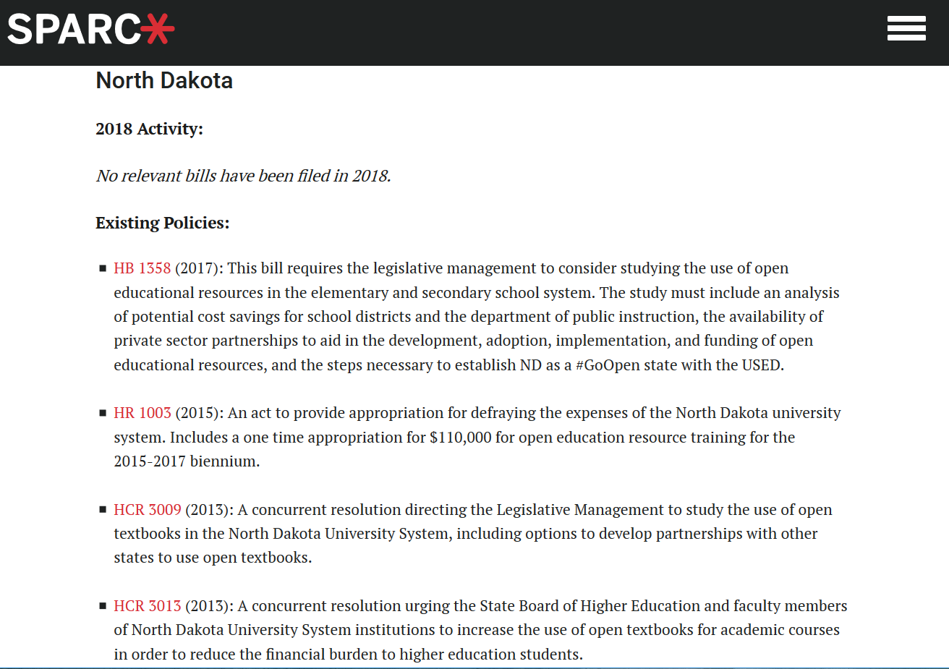
ND is part of that small number of states funding OERs
From SPARC’s State Policy Tracker: https://sparcopen.org/our-work/state-policy-tracking/
CC-BY 4.0 License 2024 Devon Olson, MLIS, AHIP

Slide 39
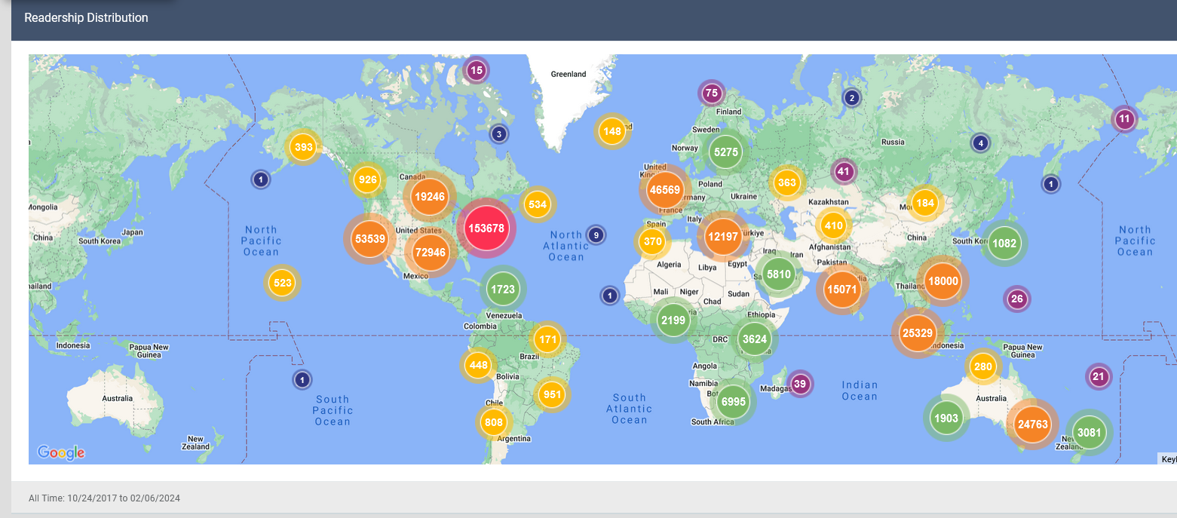
And readers of OT-created resources on UND’s institutional repository is global
Map data from 2/6/2024
>>commons.und.edu
CC-BY 4.0 License 2024 Devon Olson, MLIS, AHIP

Slide 40
Downloads of OT dept. capstones & CATs since Sept. 2017
CC-BY 4.0 License 2024 Devon Olson, MLIS, AHIP

Slide 41
Re-use Activity!
Divide into groups
Work through the re-use case studies
Answer the questions in the online form: https://und.libwizard.com/f/ot403reuseactivity
CC-BY 4.0 License 2024 Devon Olson, MLIS, AHIP

Slide 42
2013: just five for-profit publishing companies,
Reed Elsevier
Springer Science+Business Media
Wiley-Blackwell
Taylor&Francis
and Sage,
accounted for 50% of all articles published.
CC-BY 4.0 License 2024 Devon Olson, MLIS, AHIP

Slide 43
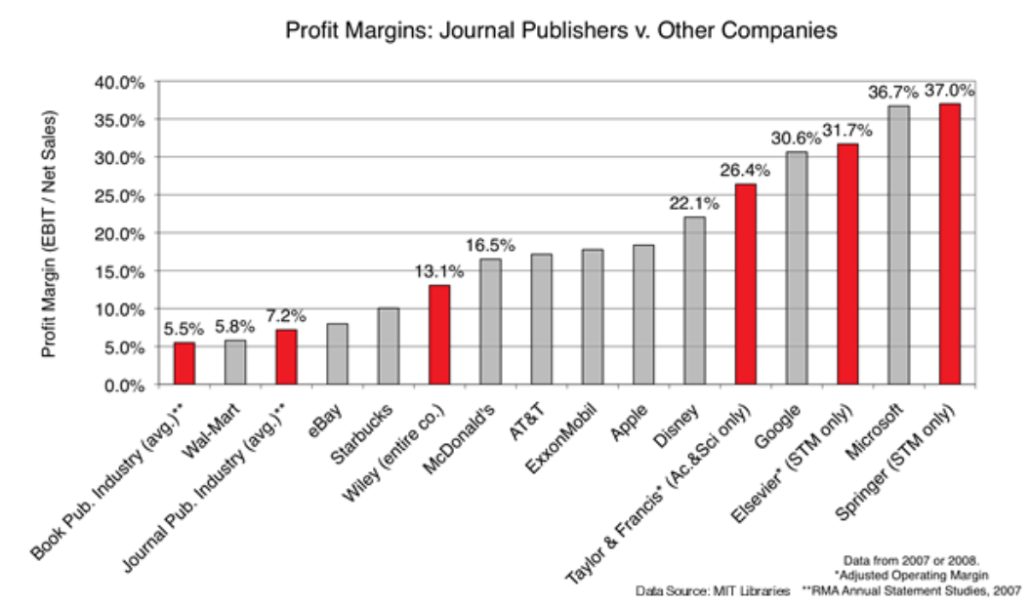
Speaking of money…
Academic journal publishers are some of the most profitable companies in the world
CC-BY 4.0 License 2024 Devon Olson, MLIS, AHIP
http://www.righttoresearch.org/learn/problem/index.shtml#Image_1

Slide 44
Late 2019:
University of California canceled their contract with Elsevier
UC accounts for nearly 10% of the US’s publications
McKenzie 2019
CC-BY 4.0 License 2024 Devon Olson, MLIS, AHIP

Slide 45
Late 2019:
University of California canceled their contract with Elsevier
UC accounts for nearly 10% of the US’s publications
Other journals that have canceled big-deals:
CalTech
California State U
Amherst college
U Wisconsin-Milwaukee
George Mason U
St. John’s U
SUNY Buffalo
SUNY Potsdam
UNC Chapel Hill
U of Montreal
McKenzie 2019
Anderson 2017
CC-BY 4.0 License 2024 Devon Olson, MLIS, AHIP
Notes:
In 2017, one librarian did an informal poll and found that 24 of 31 libraries they contacted had canceled a “big-deal” subscription, with 79% of the cancellations taking place between 2015 and 2017

Slide 46
Publishing also has a lot of equity work to do
2018: Workplace Equity Project (WE) survey of scholarly publishers (Taylor 2020)
Found imbalances in diversity inherent in the workforce
96% with a Bachelor's degree or higher,
76% female,
83% heterosexual,
81% White,
and 89% report no disabilities
CC-BY 4.0 License 2024 Devon Olson, MLIS, AHIP

Slide 47
Publishing also has a lot of equity work to do
2018: Workplace Equity Project (WE) survey of scholarly publishers (Taylor 2020)
The chances of attaining a senior position in scholarly publishing are higher for White males with no tertiary‐level qualifications than for Black females with postgraduate degrees.
Direct line management practice defines individual experience irrespective of organizational policy.
Most demographic groups (with the exception of the Black cohort) recognize their own challenges but are blind to the bias experienced by other groups.
CC-BY 4.0 License 2024 Devon Olson, MLIS, AHIP

Slide 48
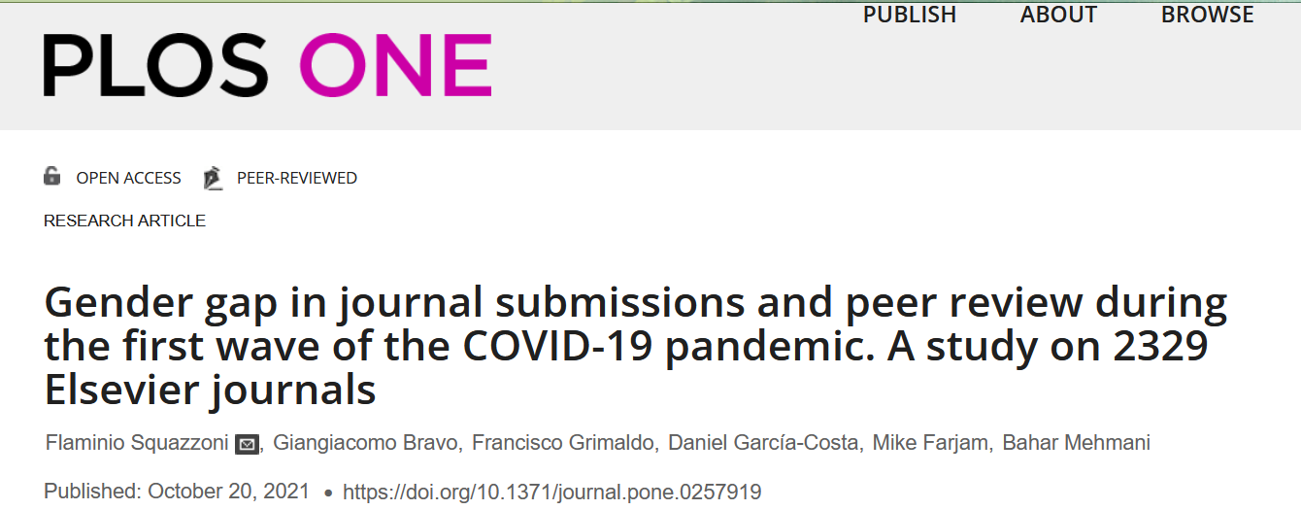
2021:
And covid did not help
Abstract
During the early months of the COVID-19 pandemic, there was an unusually high submission rate of scholarly articles. Given that most academics were forced to work from home, the competing demands for familial duties may have penalized the scientific productivity of women. To test this hypothesis, we looked at submitted manuscripts and peer review activities for all Elsevier journals between February and May 2018-2020, including data on over 5 million authors and referees. Results showed that during the first wave of the pandemic, women submitted proportionally fewer manuscripts than men. This deficit was especially pronounced among more junior cohorts of women academics. The rate of the peer-review invitation acceptance showed a less pronounced gender pattern with women taking on a greater service responsibility for journals, except for health & medicine, the field where the impact of COVID-19 research has been more prominent. Our findings suggest that the first wave of the pandemic has created potentially cumulative advantages for men.
CC-BY 4.0 License 2024 Devon Olson, MLIS, AHIP

Slide 49
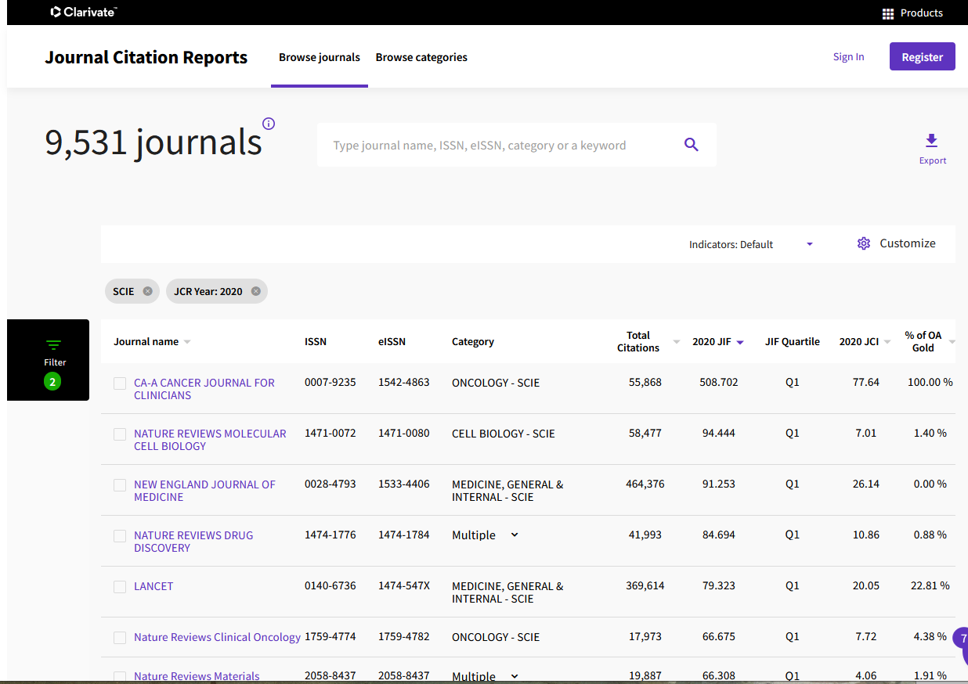
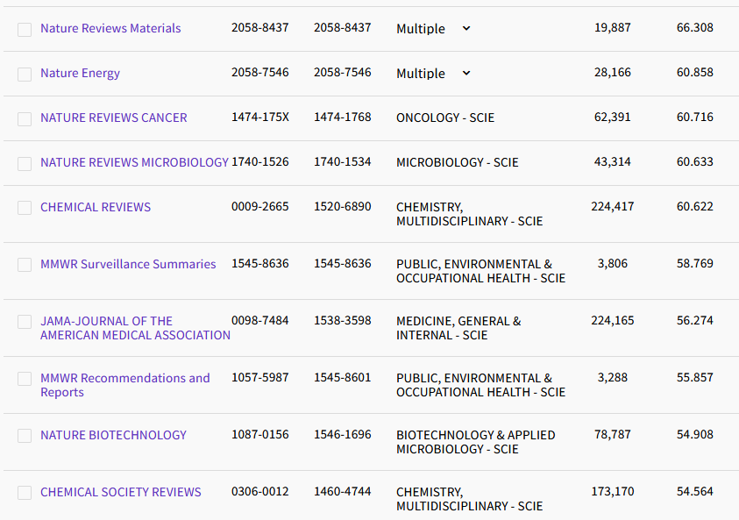
2022:Metrics reflect inequity
CC-BY 4.0 License 2024 Devon Olson, MLIS, AHIP

Slide 50
2022:Metrics reflect inequity
CC-BY 4.0 License 2024 Devon Olson, MLIS, AHIP

Slide 51
2022:Metrics reflect inequity
English Language
English Language
English Language
English Language
English Language
English Language
English Language
English Language
English Language
English Language
English Language
English Language
English Language
English Language
English Language
English Language
CC-BY 4.0 License 2024 Devon Olson, MLIS, AHIP

Slide 52
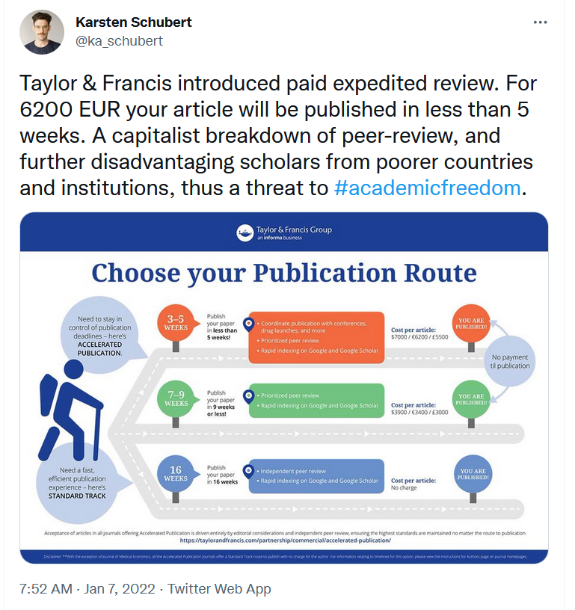
2022:
Inequity is in the process, too.
CC-BY 4.0 License 2024 Devon Olson, MLIS, AHIP

Slide 53
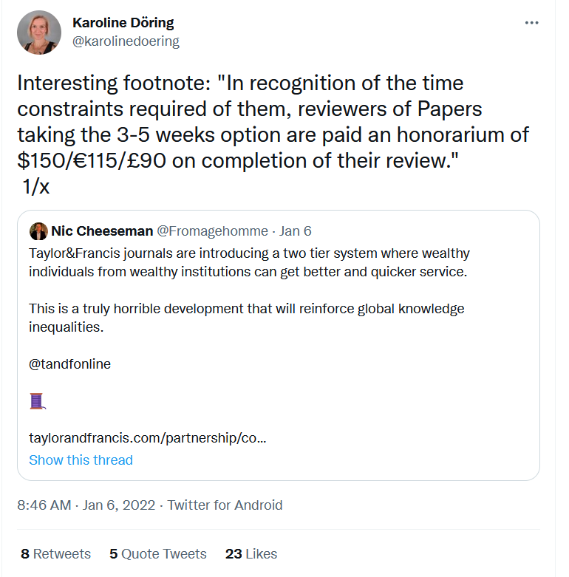
2022:
Metrics reflect inequity
CC-BY 4.0 License 2024 Devon Olson, MLIS, AHIP

Slide 54
2022:
Metrics reflect inequity
The estimated monetary value of the time US-based reviewers spent on reviews was over 1.5 billion USD in 2020
Aczel, B., Szaszi, B., & Holcombe, A. O. (2021).
CC-BY 4.0 License 2024 Devon Olson, MLIS, AHIP

Slide 55
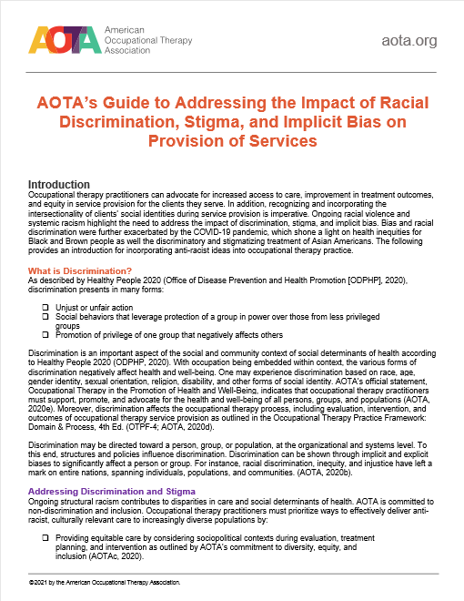
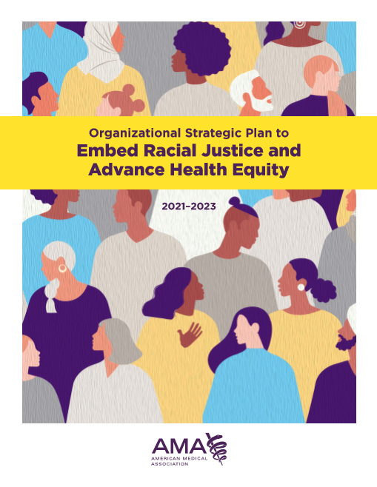
2021:
But there are signs of positive change
CC-BY 4.0 License 2024 Devon Olson, MLIS, AHIP

Slide 56
2022: Signs of positive change:
NIH Policy for Data Management and Sharing
Dr. Glaucomflecken, “Big News In Academic Publishing”, Sept. 2022
CC-BY 4.0 License 2024 Devon Olson, MLIS, AHIP

Slide 57
Journal investigation activity
Review the websites of 4 different journals
Navigate to the google form
Answer the following
For each journal, what culture or country’s perspective is privileged? Is this a truly “international” journal?
Look at the editorial board: Does the website list where they are based?
In the most recent issue, are most of the articles from one place? How can you tell?
Arrange the journals by what you think their impact factors are (without looking them up!), highest impact factor to lowest. Why did you arrange them like you did?
CC-BY 4.0 License 2024 Devon Olson, MLIS, AHIP

Slide 58
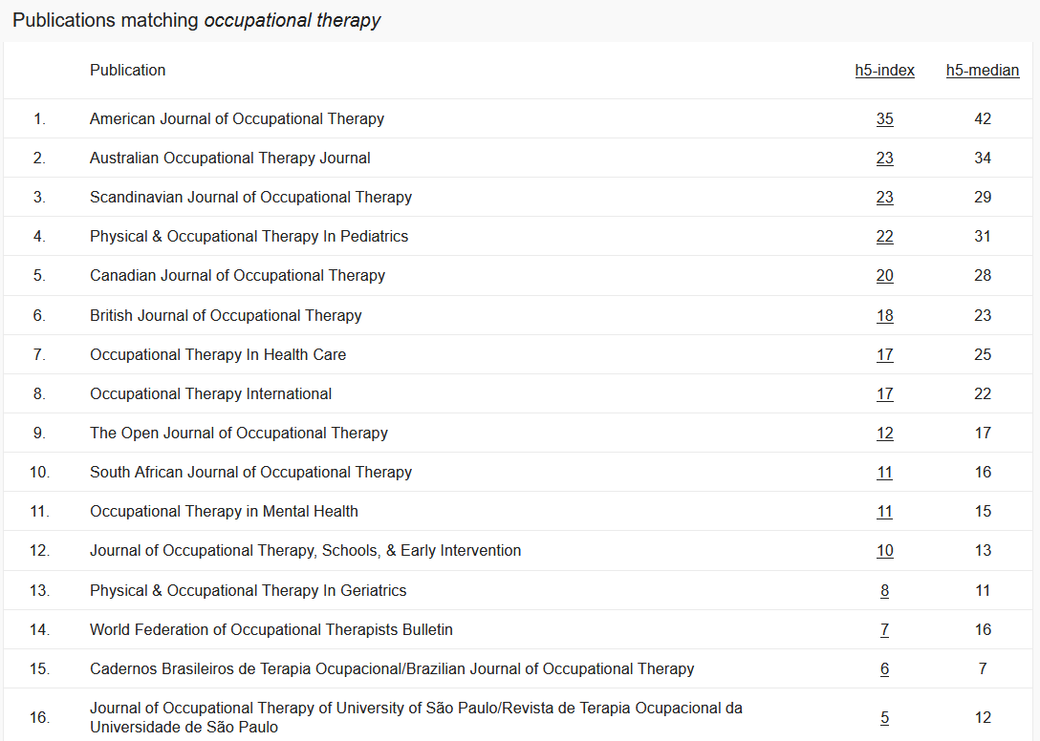
Journal investigation activity
CC-BY 4.0 License 2024 Devon Olson, MLIS, AHIP

Slide 59
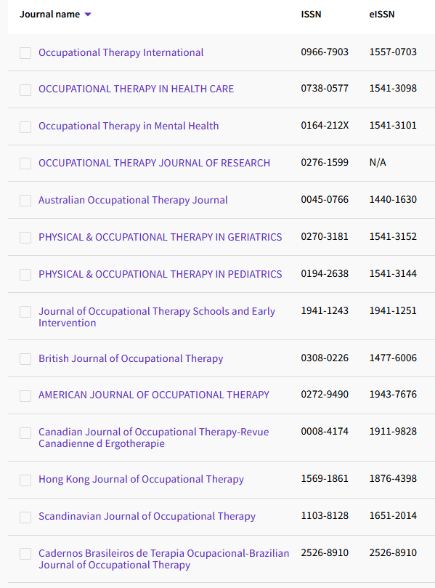
English Language
English Language
English Language
English Language
English Language
English Language
English Language
French Language
English Language
English Language
English Language
English Language
English Language
English Language
CC-BY 4.0 License 2024 Devon Olson, MLIS, AHIP
Portuguese Language
Spanish Language
English Language

Slide 60
Thank you!
Devon Olson, MLIS, AHIP
devon.olson.2@med.und.edu
CC-BY 4.0 License 2024 Devon Olson, MLIS, AHIP

Slide 61
Sources
Aczel, B., Szaszi, B., & Holcombe, A. O. (2021). A billion-dollar donation: estimating the cost of researchers’ time spent on peer review. Research Integrity and Peer Review, 6(1), 14. https://doi.org/10.1186/s41073-021-00118-2
Altbach, P. G. (1978). Scholarly Publishing in the Third World. Library Trends. Spring. 489-503.
Anderson, R, (2017) ‘When the Wolf Finally Arrives: Big Deal Cancellations in North American Libraries ‘Scholarly Kitchen blog, 1 May 2017. https://scholarlykitchen.sspnet.org/2017/05/01/wolf-finally-arrives-big-deal-cancelations-northamerican-libraries/
Clark, R. (2012, 13 July). Information Wants to be Free. [Blog post]. Retrieved from http://www.rogerclarke.com/II/IWtbF.html
Fyfe, A., Coate, K., Curry, S., Lawson, S., Moxham, N., & Røstvik, C. M. (2017). Untangling Academic Publishing: A history of the relationship between commercial interests, academic prestige and the circulation of research. Zenodo. https://doi.org/10.5281/zenodo.546100
Guttenplan, D. D. (2010-11-01). "For Exposure, Universities Put Courses on the Web". New York Times.
Hall, B. L., & Tandon, R. (2016). Decolonization of knowledge, epistemicide, participatory research and higher education. Research for All, 1(1). https://doi.org/10.18546/RFA.01.1.02
Johnstone, Sally M. (2005). "Open Educational Resources Serve the World". Educause Quarterly. 28 (3). Retrieved 2010-11-01
Larivière, V., Haustein, S., Mongeon, P.. 2015. The Oligopoly of Academic Publishers in the Digital Era. PLOS. https://doi.org/10.1371/journal.pone.0127502
Lijuan Xu (22 Jan 2024): Information Literacy through the Lens of Epistemic Justice: Centering the Missing and Unheard Voices of Marginalized Groups, New Review of Academic Librarianship, DOI: 10.1080/13614533.2024.2306366
New York. Retrieved 2010-12-19
McKenzie, L. (2019). UC Drops Elsevier. Inside Higher Ed. https://www.insidehighered.com/news/2019/03/01/university-california-cancels-deal-elsevier-after-months-negotiations
OER IPR Support.
Santos, B. de S. (2015). Epistemologies of the South: Justice Against Epistemicide. Routledge.
SPARC https://sparcopen.org/who-we-are/
SPARC. 2018. Open Education Fact Sheet
Taylor, S. Spilka, S. Monahan, K., Mulhern, I., Watcher, J. (2020). Evaluating equity in scholarly publishing. Learned Publishing, 33(4), 353-367. https://doi.org/10.1002/leap.1301
The Digital Millennium Copyright Act | U.S. Copyright Office. (n.d.). Retrieved November 9, 2021, from https://www.copyright.gov/dmca/
US National Institutes of Health. (2020). NIH Policy for Data Management and Sharing (Publication NOT-OD-21-013). https://grants.nih.gov/grants/guide/notice-files/NOT-OD-21-013.html
U.S. PIRG Education Fund and the Student PIRGs. 2014. Fixing the Broken Textbook Market. http://www.studentpirgs.org/reports/sp/fixing-broken-textbook-market
U.S. Copyright Office. More Information on Fair Use. https://www.copyright.gov/fair-use/more-info.html
Van Noorden, R. (2017). Publishers threaten to remove millions of papers from ResearchGate. Nature. https://doi.org/10.1038/nature.2017.22793
The Serviceberry: An Economy of Abundance – Robin Wall Kimmerer. (2022). Emergence Magazine. October 26 2022. Retrieved December 16, 2022, from https://emergencemagazine.org/essay/the-serviceberry/
CC-BY 4.0 License 2024 Devon Olson, MLIS, AHIP

