Slide 1
Data Management With Pokemon
Brittany Fischer, Scholarly Communication Librarian Zeineb Yousif, Digital Initiatives Librarian
Notes:
Hello everyone! My name is Zeineb Yousif and I’m the Digital Initiatives Librarian at the Chester Fritz Library. This is my colleague, Brittany Fischer, the Scholarly Communications Librarian. Welcome to Data Management with Pokemon! This is an introductory workshop where we’ll be going over some basic data management concepts through the lens of Pokemon. For those of you with experience with data management, this will hopefully serve as a fun refresher, and for those of you new to the topic you’ll learn some foundational concepts and ideally walk away interested in learning more! Before we get started we wanted to give full credit to Hannah Gunderson, a data librarian at Carnegie Mellon University who created the original workshop we’ve adapted to share with you today.

Slide 2
Workshop Outline
Data Management 101
Let’s name some Pokémon images! (File naming)
Pokémon drawing activity (Documentation)
Creating a Pokédex codebook (Codebooks/data dictionaries)
Notes:
Let’s start with giving you an idea of what we’ll be doing today. Today’s workshop will be very activity oriented. We’ll start with giving you a brief introduction to data management, move on to practicing file naming with Pokemon images, documentation through drawing Pokemon, and then wrap things up by showing how a codebook could be used to help make sense of a Pokedex. If you have any questions as we go please feel free to ask in chat or over voice!

Slide 3
Data Management 101
Notes:
What is data? Data is a pretty broad term. It can describe a collection of facts which could include: numbers, words, measurements, observations, or descriptions of things. All disciplines have data, the humanities included! In history, data might look like a collection of documents. In biology, it might be a set of observations on animals. In computational science, it could consist of a software package. Data management is the process of managing these facts so we can get the most out of them and achieve a stronger impact with our work.
Data management activities include: organizing, describing, documenting, tidying, naming, and sharing your data. You might not think of it in those terms, but you probably practice data management skills already! Today, we’re going to go through some exercises with Pokemon that illustrate how to practice different data management skills.

Slide 4
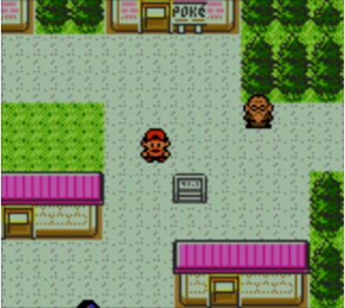
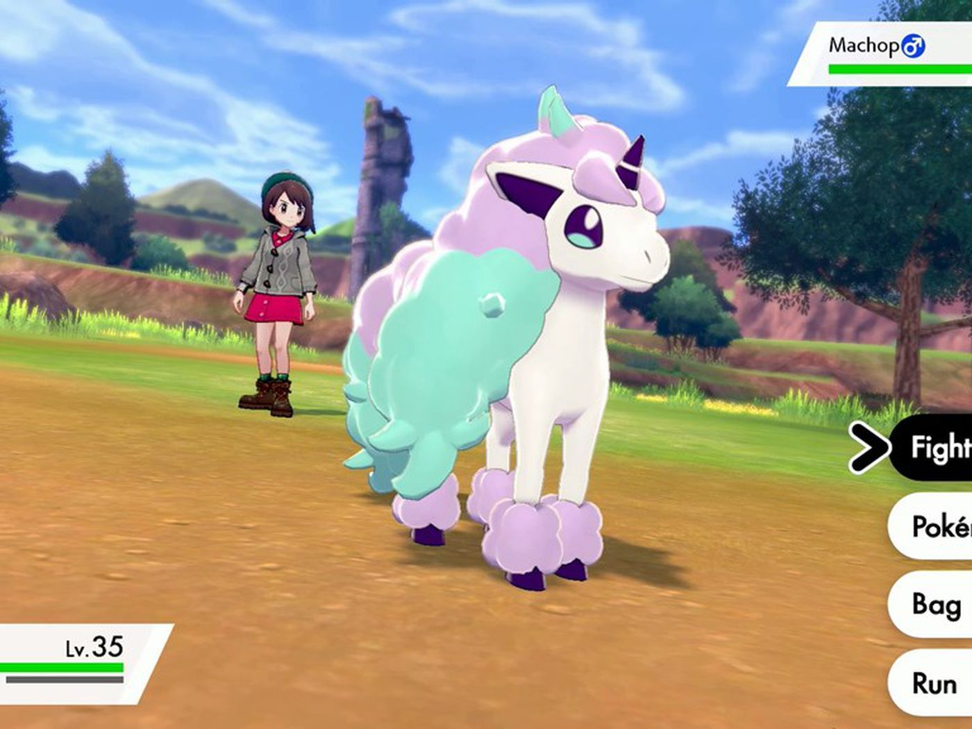
Why Pokemon?
Notes:
Why are we looking at data management through the lens of Pokemon? Aside from Pokemon being fun and cute, Pokemon involves a lot of data! For those of you not familiar with Pokemon: it’s a media franchise involving a tv show and several videogames where humans take the role of trainers who capture Pokemon creatures to battle each other and gain new skills and powers. Keeping track of various Pokemon you’ve captured, how you’ve performed in Pokebattles, and even what areas you’re likely to find certain types of Pokemon in all involves working with data. Brittany will show you as much now with our first activity.

Slide 5
Let’s name some images!
Look at each of the following images and pretend they are actual image files (.jpeg, .png, etc.) on your computer.
In the Zoom chat, type out how you would name this file on your computer, paying attention to any characters, situations, and places you see in the image - don’t hit “Enter” until I say to!
After about 15 seconds, everyone will hit “Enter” and put their responses into chat
Notes:
First up: file naming!

Slide 6
How would you name these files?

Slide 7
How would you name these files?

Slide 8
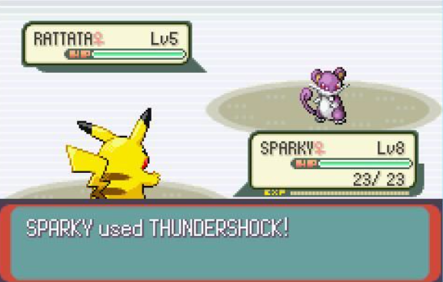
How would you name these files?

Slide 9
How would you name these files?

Slide 10
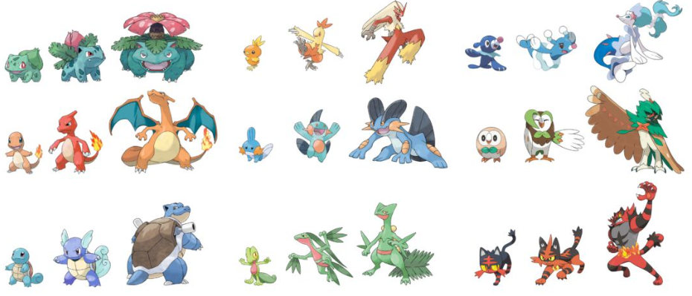
How would you name these files?

Slide 11
File Naming Tips
Include the most important elements to you + collaborators
Include creation dates written in ISO 8601 format: YYYY-MM-DD, ex: 2020-06-27
Avoid spaces or special characters in the file name; use underscores to separate elements
Ex: “20220123Yousif_map1_v1.pdf”, not “Yousif map 1.pdf”
Less than 35 characters
Any file naming convention is better than nothing, so don’t stress about “perfection”
Notes:
If you’re looking at the chat now, you’re probably seeing everyone came up with some pretty different names! That’s because we didn’t really give you any naming guidelines – or to put it another way any naming conventions. When working with data how you name your files will have a big impact on your ability to identify and retrieve your files later. Your names should be consistent and descriptive so it's clear what each file contains. Some basic guidelines to follow are:
Make sure your file names include the most important elements to you and your collaborators. You want file names that indicate what is in the file and what version it is.
Include creation dates in a yyyy-mm-dd format. This ensures your files will be sorted chronologically.
Avoid using spaces or special characters (ex. *%$) in your files names. Instead use the underscore (_) as a delimiter. Some software will not recognize spaces or special characters in file names.
Keep names as short as possible. This makes files easier to browse at a glance.
At the end of the day any file naming convention is better then nothing, so don’t stress about “perfection”. Just aim for consistency.

Slide 12
The Better Name?
PokeBattle23.jpg
RattataPikachuBattle_Round1.jpg
Notes:
Now that you know a little more about how to create good file names, let’s go back to some of the Pokemon images you worked on naming before! Type 1 or 2 in the chat to vote for which name you think is better. I’ll give you ten seconds to decide and then we’ll go over it.
Those of you who picked option 2 congratulations! As a trainer trying to keep track of your battles, being able to see which Pokemon were involved in the name is much more helpful than just seeing a number.

Slide 13
The Better Name?
PikachuMrMimeHelioptileEating.jpg
Mr. Mime and Pikachu and Helioptile Having Dinner.jpg
Notes:
Let’s try another image! Type 1 or 2 in the chat to indicate which file name you think is better.
(10 second pause)
If you picked option 1, good catch! The second name includes spaces and a period in the file name – characters that might trip up the software you use to keep track of your Pokemon images! It’s also quite long making it more difficult for you to browse quickly.

Slide 14
Drawing activity
Use this link to find a Pokémon of your choice: https://tinyurl.com/pokemon-workshop
Without naming the Pokémon, type out a list of steps in the Sharepoint document for how another person might draw this Pokémon. Use appropriate terms (colors, body size/type, and other features) to describe the Pokémon. Aim for 10 or less steps.
Share these steps with the rest of the group.
On a piece of paper, try to draw the Pokémon based on the other person’s description! We’ll share what we came up with at the end of the activity.
Notes:
Now that you’ve had some practice with file naming, we’re going to move on other important data management skill – documentation! In this activity we’ll be having you write up instructions on how to draw different Pokemon. [read out slide]

Slide 15
Why Documentation Matters
Detailed documentation ensures data reproducibility. If data is not reproducible it is less trustworthy.
Notes:
How close did everyone’s Pokemon drawing get to looking like an actual Pokemon? Were you able to have a good idea of what you were trying to draw based off your instructions? It can be tricky, right? Up on the slide I’ve got an image of a Maractus and beside it a picture someone drew based off a combination of their memory and descriptions of their friends. If any of you happen to watch the Drawfee show on Youtube this is from their ‘Draw Pokemon from Memory’ series. As you can see…it’s not the most accurate representation of a Maractus. Without good detailed instructions, it’s hard to replicate the image being described.
This is a great example of why documentation matters! When working with data, it’s important to document your process. Documentation ensures that your data can be understood and interpreted by any user. It should explain how your data was created, what the context is for the data, the structure of the data and its contents, and any manipulations that have been done to the data. If your documentation has been done well, a user should be able to recreate or analyze your data in order to confirm your results. Reproducibility is key to validating scientific knowledge.

Slide 16
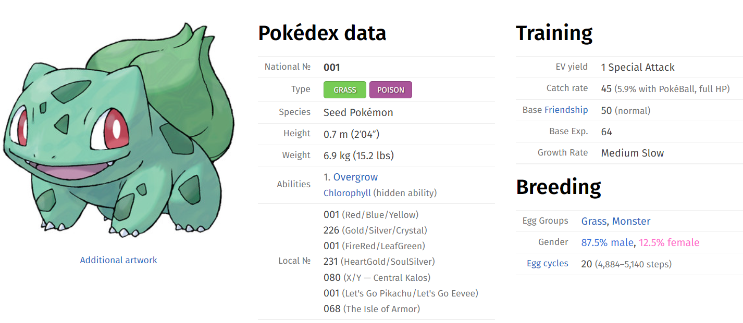
Creating a Pokédex Codebook
A codebook describes the contents, structure, and layout of a data collection. Information for each variable in a codebook is intended to be complete and self-explanatory.
Notes:
A great tool for documentation is having a codebook or a data dictionary. A codebook describes the contents, structure, and layout of a data collection. Information for each variable in a codebook is intended to be complete and self-explanatory. We’ll illustrate how a codebook should work with the example of a Pokedex.
[show Pokedex entry] A Pokedex is a detailed index of Pokemon – you can think of it as a dataset about Pokemon. If you look at this Pokedex entry, you can see there’s a lot of information but it’s missing context. We have a field for HP – what does that stand for? What’s an Attack and how is different from Sp. Attack? What are these icons for type defenses meant to indicate? The data is here but we’re lacking information needed to make sense of the variables.

Slide 17
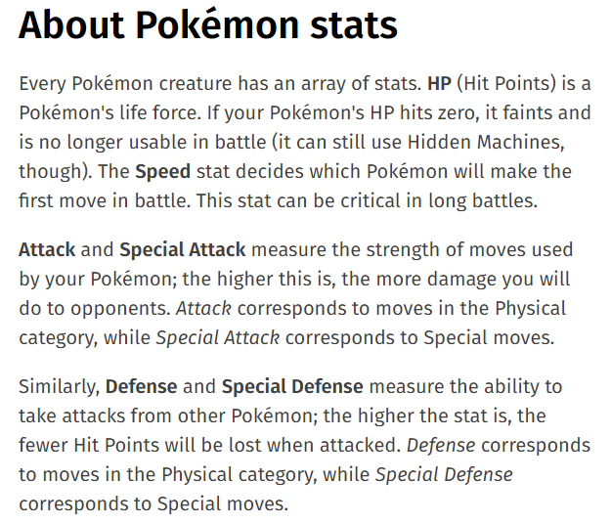
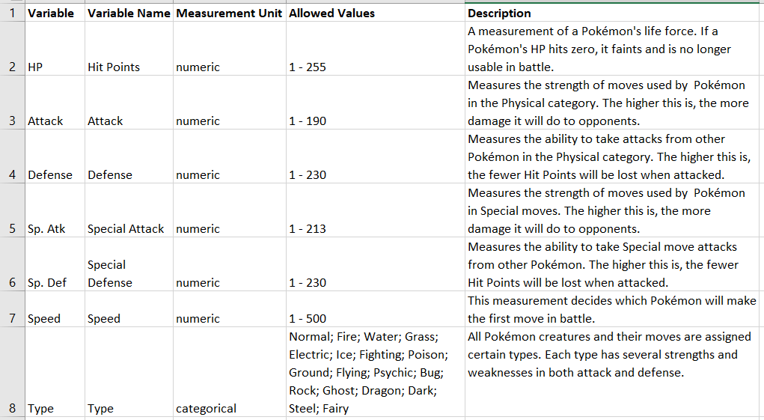
Pokédex as Codebook
Notes:
[about excerpt] If you look and explore the Pokedex website further though, you’ll see the contextual information needed to understand Pokedex entries is available elsewhere in the site! The about page explains the meaning of several variables and if you look elsewhere there are pages going over different Pokemon types – i.e. letting us know what range of values the type category entails. If we were to put this all together into a codebook entry it would look something like this.
[show Pokedex codebook example]
In our Pokedex codebook we include the full name of each variable, how it is measured, what the allowed values are, and a description of what each variable indicates. This is all the information needed to make sense of the Pokedex as a dataset. You could make a similar codebook for any dataset you put together. A good codebook should contain enough information that a new researcher would be able to make sense of all the variables tracked in your data and understand what they indicate.

Slide 18
Further Resources
Digital Initiatives Librarian
zeineb.yousif@und.edu
Notes:
And that brings us to the last of our Pokemon and data activities! No need to stop there though! If you’re interested in learning more about data management the library has resources for you. You can check out our data management research guide for help through different steps of managing your data or contact me at zeineb.yousif@und.edu for a data management consultation. As the Digital Initiatives Librarian data management falls under my job responsibilities, so I can offer help with creating data management plans or just figuring out a place to safely deposit a dataset if you’d like to make it public.

Slide 19
Got Data?
Have a dataset to deposit? Use the UND Scholarly Commons
Notes:
On that theme! The library maintains a data collection on UND’s institutional repository, the UND Scholarly Commons. If you’re looking for a permanent home for your data but can’t quite seem to find a place that fits, contact me for a data management consultation. The library can offer ongoing stewardship of your datasets or advice on other suitable repositories you may not have considered.

Slide 20
What Else You Got?
Finding Data with Holly Gabriel and Brittany Fischer
Data Cleanup Using OpenRefine with Heather Rogers and Zeineb Yousif
Data Visualization with Tableau with Heather Rogers and Zeineb Yousif
Check the workshop research guide for more!
https://libguides.und.edu/cflworkshops
Notes:
This is probably the first library workshop on data management you’ve attended but not the first the library has offered! Last year we did a series of workshops on digital scholarship that covered more advanced areas of data management. If you’re looking for tips on how to find data to work with, clean the data that you have, or create visualizations that share the data story you want to tell, these are a good resource for you. The recordings are linked on these slides which we’ll make available after this workshop or can be found on the library workshop research guide.

Slide 21
Notes:
Thank you for your time! Do you have any questions?

Slide 22
Credits
This workshop was adapted from Hannah Gunderson’s “Learn Data Management Through Pokemon!” available at https://osf.io/v6m38/
All Pokemon images taken from Bulbapedia
Attempted Maractus drawing screenshot taken from the episode Three Artists Try Drawing Pokémon from Memory by the Drawfee Show
Pokemon ‘Questions’ image adapted from: https://www.funkidslive.com/quiz/guess-pokemon-quiz/

