Slide 1
OERs: A Brief Overview
Jackson Harper
University of North Dakota
OER Librarian

Slide 2
Agenda
What Are OER?
Why Use OER?
Licensing
OER Repositories
Questions/Final Thoughts

Slide 3
Defining Open Educational Resources
In his blog, Improving Learning, David Wiley defines open content and open educational resources as copyrightable work that is either in the public domain or licensed to allow others free and unending permission to interact with the content through the 5R affordances (see next slide).

Slide 4
5R Affordances
Retain: Create, keep and control a copy of the resource
Reuse: Use the resource as is (Wiley, 2024)
Image courtesy of Twisted Realm (CC BY)
Notes:
Download and keep a copy
Can translate into another language
“mashup”
Share on a website use in a presentation or in class
Post a copy online

Slide 5
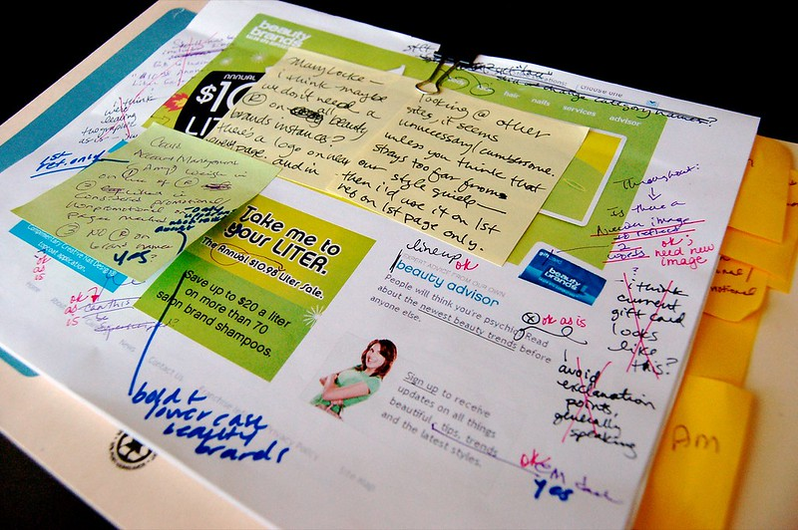
5R Affordances
Revise: Adapt, modify, change, or alter your copy of the resource (Wiley, 2024)
Image courtesy of chris riebschlager (CC BY-NC)
Notes:
Download and keep a copy
Can translate into another language
“mashup”
Share on a website use in a presentation or in class
Post a copy online

Slide 6
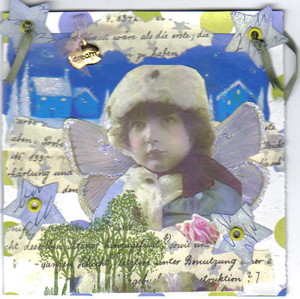
5R Affordances
Remix: Create a new resource by adding existing OER material to the original or your revised copy (Wiley, 2024)
Image courtesy of Norma (CC BY-NC)
Notes:
Download and keep a copy
Can translate into another language
“mashup”
Share on a website use in a presentation or in class
Post a copy online

Slide 7
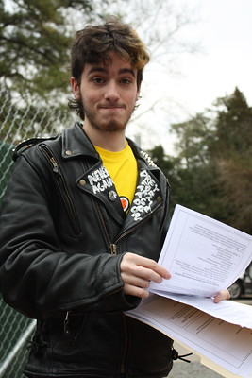
5R Affordances
Redistribute: Share copies of the original, revised, or remixed resource
(Wiley, 2024)
Image courtesy of Sarah Ross (CC BY-NC)
Notes:
Download and keep a copy
Can translate into another language
“mashup”
Share on a website use in a presentation or in class
Post a copy online

Slide 8
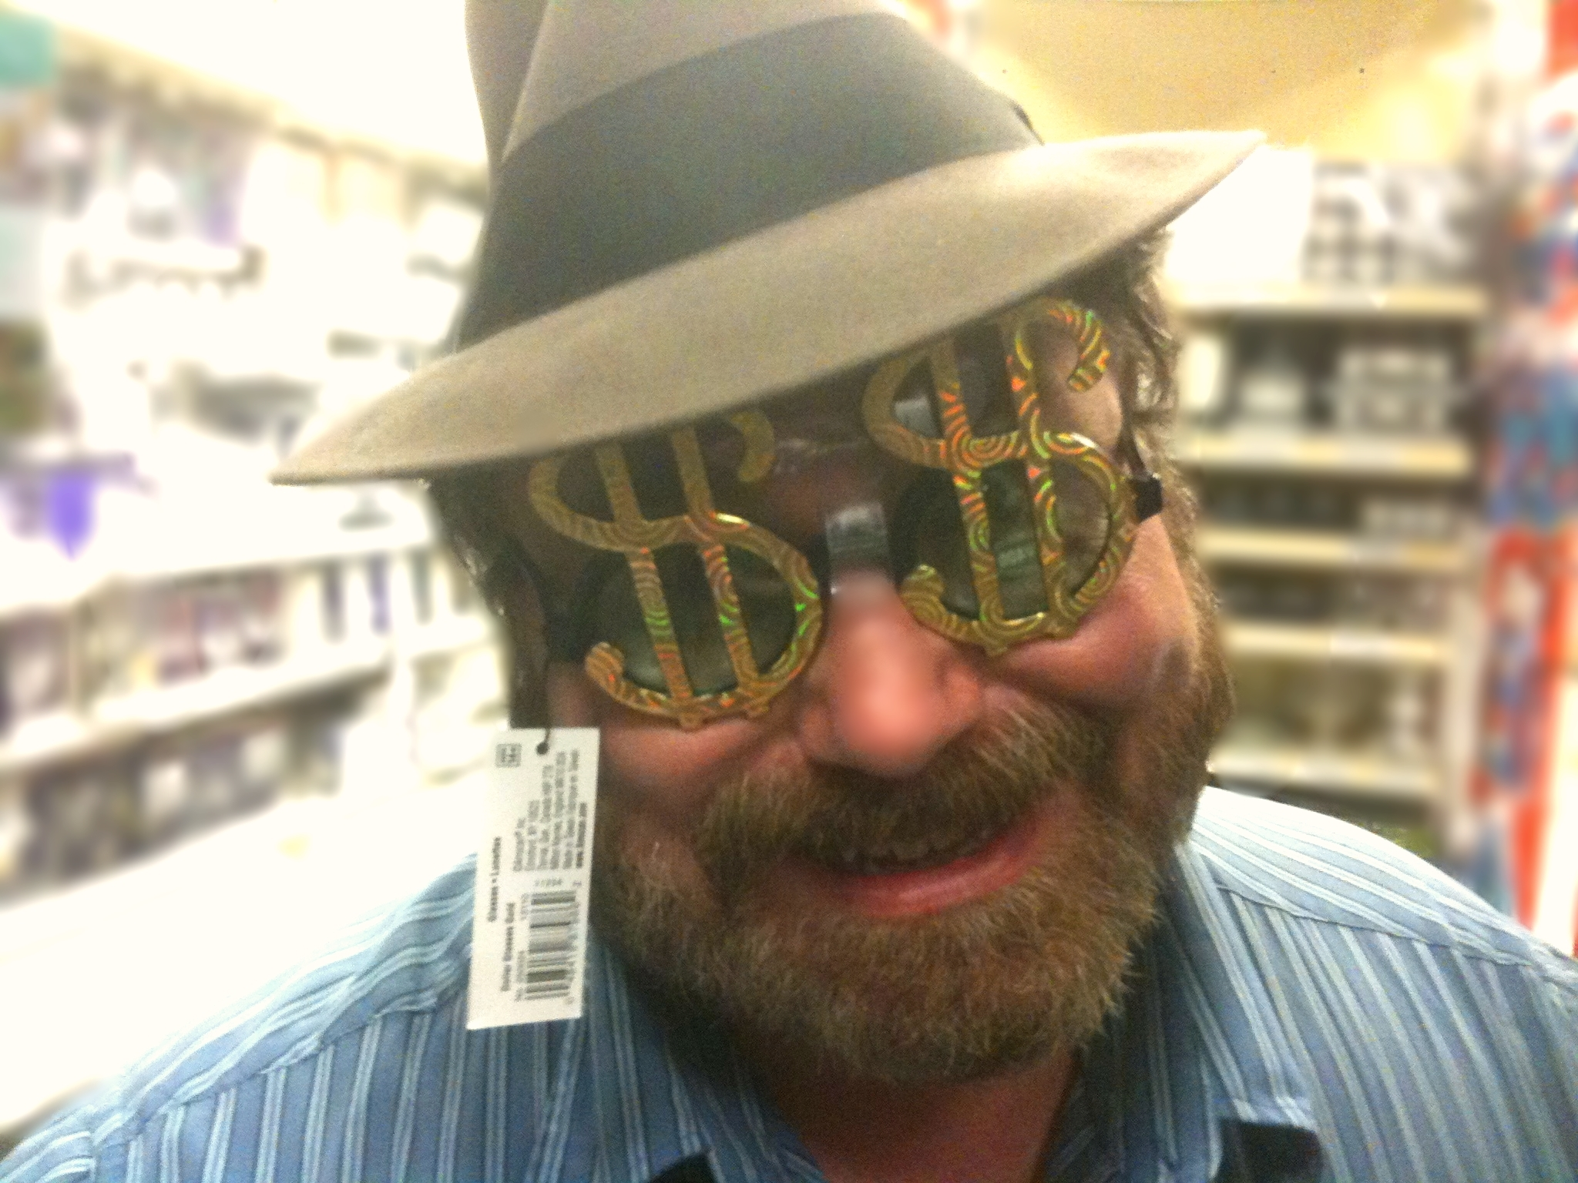
Why Use OER?
Affordability
Pedagogy
Image courtesy of Mike Mozart (CC BY)
Image courtesy of Filip Pticek (CC BY)

Slide 9
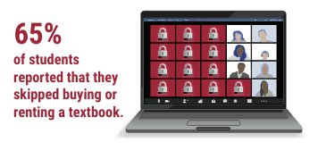
Textbooks Are Expensive
Students may forego pricey course materials
Also applies to access codes
21% skipped out
Food insecure students even more likely to skip textbooks
86% skipped versus 65% of general population
(Nagle & Vitez, 2021)
Image courtesy of U.S. PIRG Education Fund, (CC BY), 2021
Notes:
2. Saves students $$--textbooks costs are rising – cost less to print than purchase a textbook
3. Get information on day 1– no waiting for books to arrive, student, parent, or loan payment
4. Information can be updated since a copy is in hand
5. Can translate into another language--affordable for all students—equals playing field for all student income levels

Slide 10
OERs Are Flexible
OERs can be adjusted to fit the context and objectives of a course
Add (or subtract) info in response to current events or local concerns
Include underrepresented perspectives in content
Image courtesy of Canon in 2D (CC BY)
Notes:
2. Saves students $$--textbooks costs are rising – cost less to print than purchase a textbook
3. Get information on day 1– no waiting for books to arrive, student, parent, or loan payment
4. Information can be updated since a copy is in hand
5. Can translate into another language--affordable for all students—equals playing field for all student income levels

Slide 11
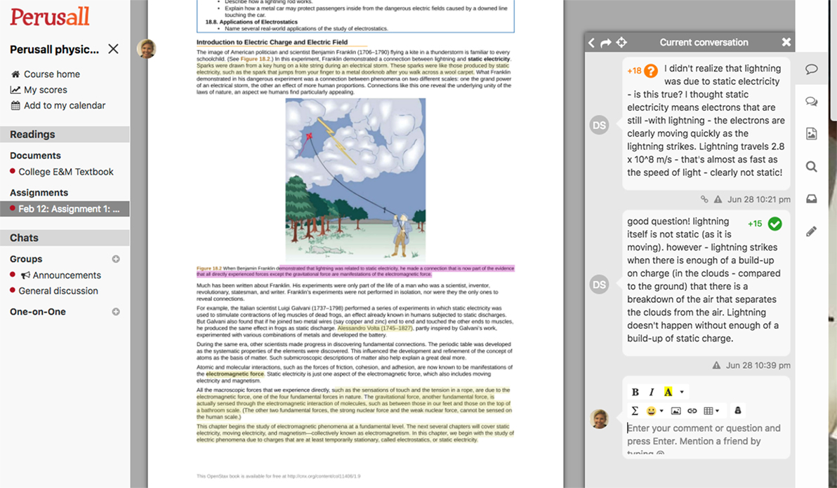
Open Pedagogy
Open Pedagogy: Teaching practices open to collaboration with learners and sharing classroom products
Students can more readily influence course content
Renewable Assignments: Classroom projects that can be used by others outside a class and after it has concluded
Image courtesy of Miller, Lukoff, King, & Mazur (CC BY)
Notes:
2. Saves students $$--textbooks costs are rising – cost less to print than purchase a textbook
3. Get information on day 1– no waiting for books to arrive, student, parent, or loan payment
4. Information can be updated since a copy is in hand
5. Can translate into another language--affordable for all students—equals playing field for all student income levels

Slide 12
What is Open Licensing?
Copyright prevents others from using created work or “all rights reserved”.
Public domain is work in which the copyright has expired, was forfeited, or is inapplicable due to the creative author being dead for a specified length of time. Also included is content created by federal government employees as part of their job-- “no rights reserved”. All work can be freely adapted or reused
Open licensing allows a creator to specify how their work may be used. This does not replace copyright but works with it--“some rights reserved” .
(Open Education, n.d.)
C
pd
CC
Notes:
Copyright—retains ownership and no one else can use or reproduce without owner permission

Slide 13
Creative Commons Licenses
CC licenses are built from different combinations of permissions
Notes:
Copyright—retains ownership and no one else can use or reproduce without owner permission

Slide 14
Creative Commons Licenses
You must credit the author…
…not use the work for a commercial purpose…
…and must share your derivative works with the same permissions
Notes:
Copyright—retains ownership and no one else can use or reproduce without owner permission

Slide 15
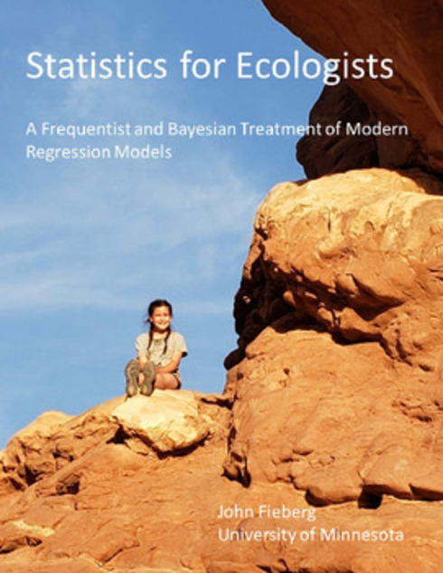
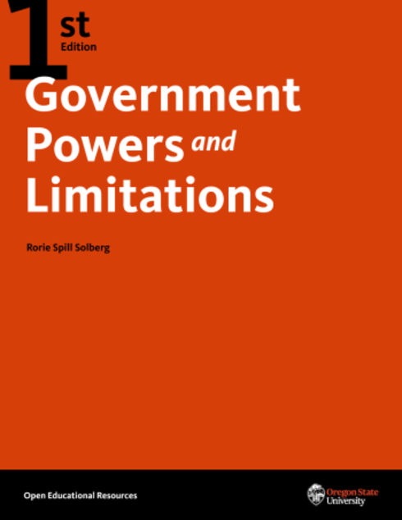
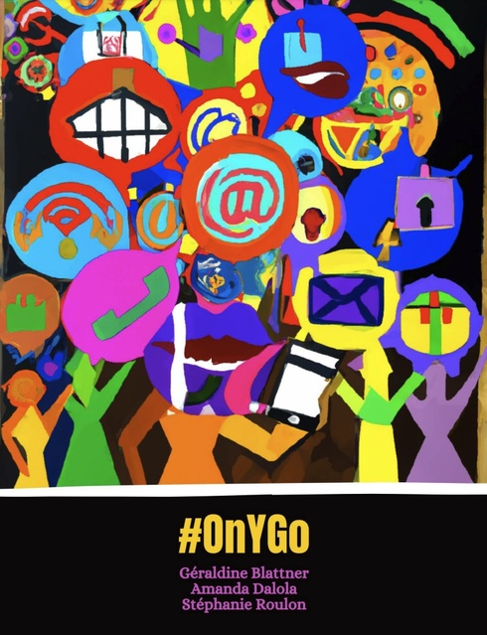
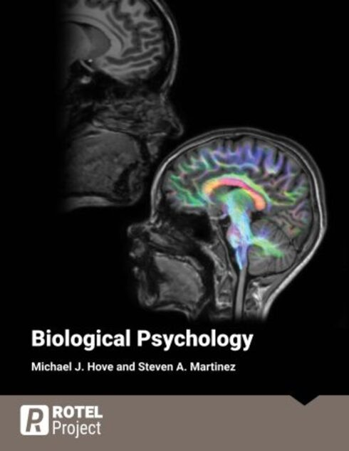
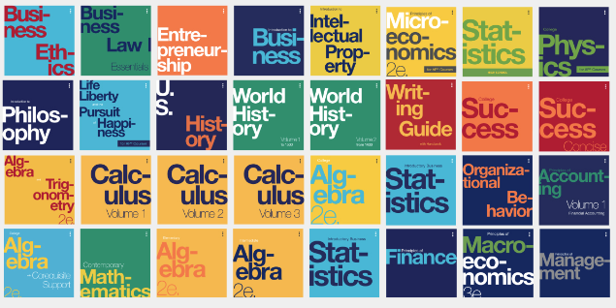
OER Repositories: First Picks

Slide 16
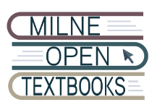
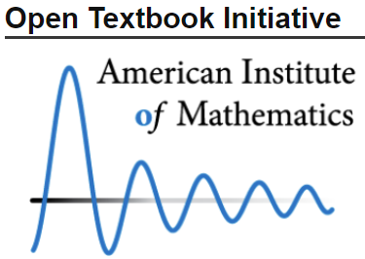
Other Respected OER Repositories

Slide 17
OER Metafinders

Slide 18
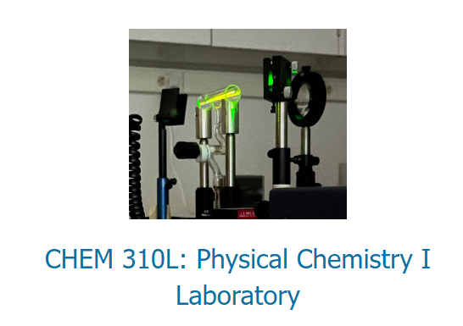
Creation Platforms

Slide 19
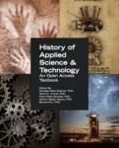
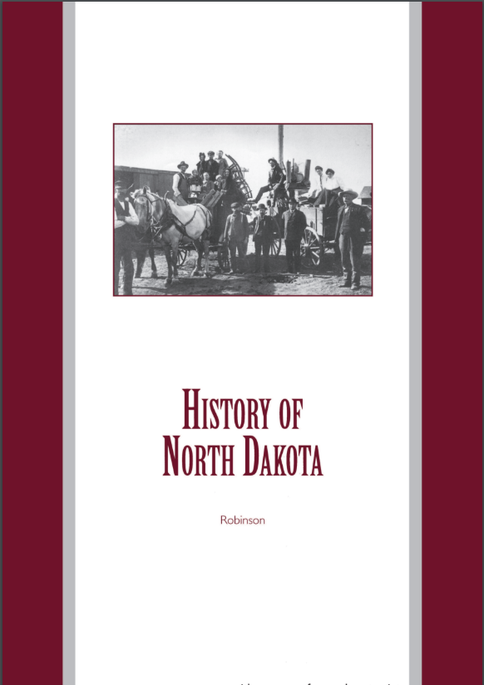
University Collections

Slide 20
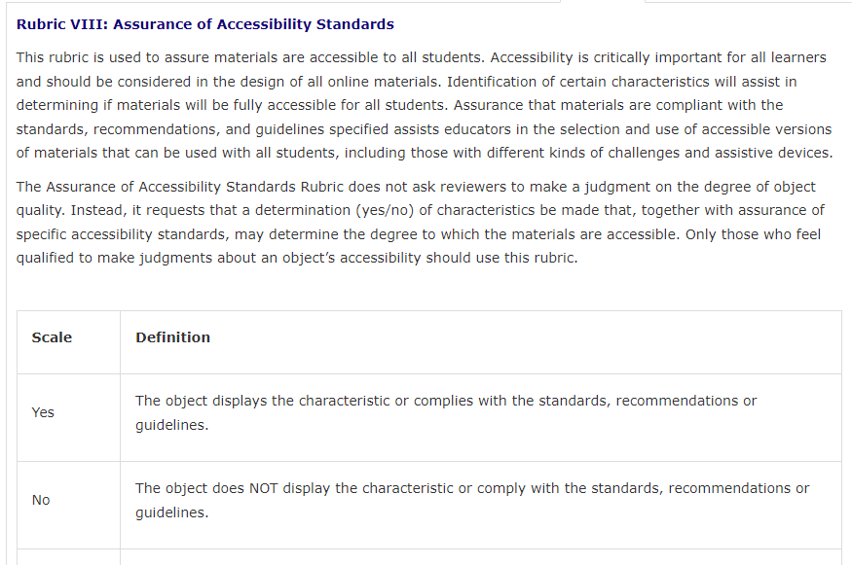
How to Evaluate OERs
Rubrics have been created specifically to review OER
Evaluate content as if it were a commercial textbook
From Prince George’s Community College Library Guide

Slide 21
Misc.
Subject-specific
Community College Consortium for OER (CCCOER)
Open Textbook: OER by Discipline Directory
Vocational Training
SkillsCommons Repository
Workforce LibreTexts
Other Colleges
Open Oregon Educational Resources
OER Commons--CARLI
More Resources
About CC Licenses - Creative Commons

Slide 22
OER Training & Support
UND OER Library Guide
The OER Starter Kit for Program Managers
Creative Commons Training
University of Hawaii OER Training
Training courses and institutes offered by organizations like SPARC
Plenty of resources and listservs if you look!

Slide 23
Questions/Comments
Jackson Harper jackson.harper@und.edu 701-777-4801

Slide 24
References
Thanks to Kathy Jo Cline for preparing the slides!
BCcampus. (n.d.). Review rubric. Open Textbook Library https://open.umn.edu/opentextbooks/reviews/rubric
Miller, K., Lukoff, B., King, G., & Mazur, E. (2018) Use of a social annotation platform for pre-class reading assignments in a flipped introductory physics class. Frontiers in Education 3(8). doi: 10.3389/feduc.2018.00008
Nagle, C. & Vitez, K. (2021). U.S. PIRG Education Fund. Fixing the broken textbook market: Third edition. https://publicinterestnetwork.org/wp-content/uploads/2021/02/Fixing-the-Broken-Textbook-Market-3e-February-2021.pdf. Accessed 2024.
Open Education Resources. OEGlobal. (n.d.). https://www.oeglobal.org/oe-resource/
Open Educational Resources (OER). Open educational resources (OER) | University of Arizona Libraries. (n.d.). https://lib.arizona.edu/find/course-materials/oer
Wiley, David. “Defining the ‘Open’ in Open Content and Open Educational Resources.” Improving Learning, https://opencontent.org/definition. Accessed 2024.

