Slide 1
Author’s Rights
What to Know Before Publishing your Work
Brittany Fischer, MLS Scholarly Communications Librarian
Zeineb Yousif, MLIS Digital Initiatives Librarian

Slide 2
Learning Outcomes
Understand copyright
Know how to work through a copyright transfer agreement
Find a journal’s rights policy
Learn strategies for negotiating contracts to make the most of your rights
Explore the benefits of protecting your rights as well as making them openly available
Notes:
By the end of this workshop you will be able to answer the following questions:
What is a copyright transfer agreement?
How can you find out a journal's rights policies?
How can you negotiate contracts to make the most of your rights as a scholar, researcher, and author?
What are the benefits of protecting your rights?

Slide 3
Can It Copyright?
Notes:
We’re going to do a quick activity to get an idea of your existing knowledge of copyright. In the next few slides I’m going to give you examples of various scenarios and ask you whether copyright would apply. You can answer in the chat or, if you prefer, just jot a note to yourself and see whether you were correct after.

Slide 4
United States Code Title 17
(a) Copyright protection subsists, in accordance with this title, in original works of authorship fixed in any tangible medium of expression, now known or later developed, from which they can be perceived, reproduced, or otherwise communicated, either directly or with the aid of a machine or device.
…
(b) In no case does copyright protection for an original work of authorship extend to any idea, procedure, process, system, method of operation, concept, principle, or discovery, regardless of the form in which it is described, explained, illustrated, or embodied in such work.
Section 102: Subject matter of copyright: In general
Notes:
In the interests of fairness I will give you a hint before we start. This is an excerpt from Title 17 of the US Code which covers the subject matter and scope of copyright. It states:
(a) Copyright protection subsists, in accordance with this title, in original works of authorship fixed in any tangible medium of expression, now known or later developed, from which they can be perceived, reproduced, or otherwise communicated, either directly or with the aid of a machine or device.
…
(b) In no case does copyright protection for an original work of authorship extend to any idea, procedure, process, system, method of operation, concept, principle, or discovery, regardless of the form in which it is described, explained, illustrated, or embodied in such work.
Keep this in mind as we go through our scenarios.

Slide 5
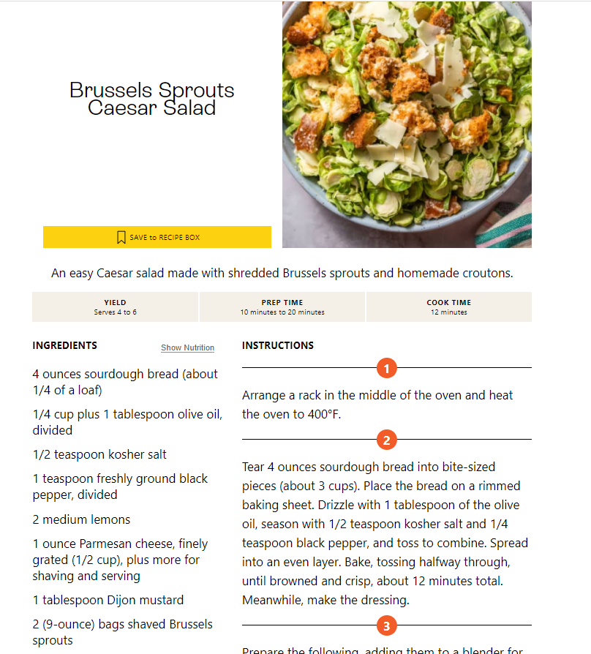
Recipe
You’ve come up with a great new recipe for a salad you hope to publish and profit from. Can you copyright it?
NO. Copyright distinguishes between ideas and expressions – ideas are not covered, expressions are. Because there is no other way to present the basic concept of a list of ingredients, recipes are generally not copyrightable. However, cookbooks can be copyrighted if the selection, arrangement, and coordination of the included recipes is creative.
Notes:
Incidentally this is why online recipes often have so much writing about their experiences of the recipes or detailed instructions – that is creative writing that is copyrightable whereas a simple list of ingredients would not be.

Slide 6
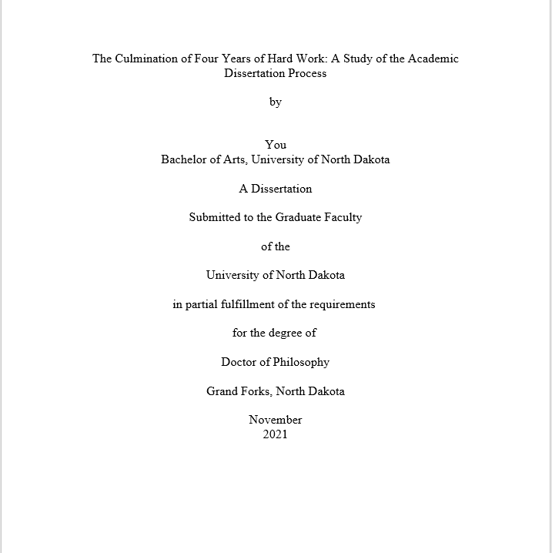
Dissertation
You’re a graduate student who has finished writing your dissertation. Can you copyright it?
YES. A dissertation is an original work in a fixed medium of expression which possesses creativity. Your dissertation is copyrighted the moment you write it.

Slide 7
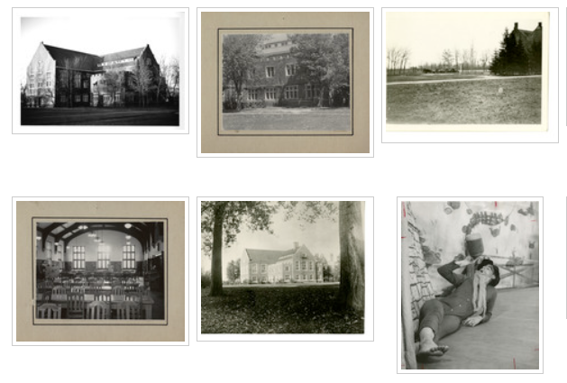
Photo Compilation
You are working on a class project that involves taking the mapped images of your street from different angles from a public domain website and adding numbers to the different images. You locate 35 different images and put them in numerical order. Can you copyright this compilation?
NO. Arranging photos in sequential order is garden-variety and does not display originality of thought. A more creative or deliberate arrangement might grant thin copyright protection.
Example adapted from an activity in “Data and Copyright: What’s Protected?” presented by Sara Rachel Benson at the 2021 Midwest Data Librarians Symposium

Slide 8
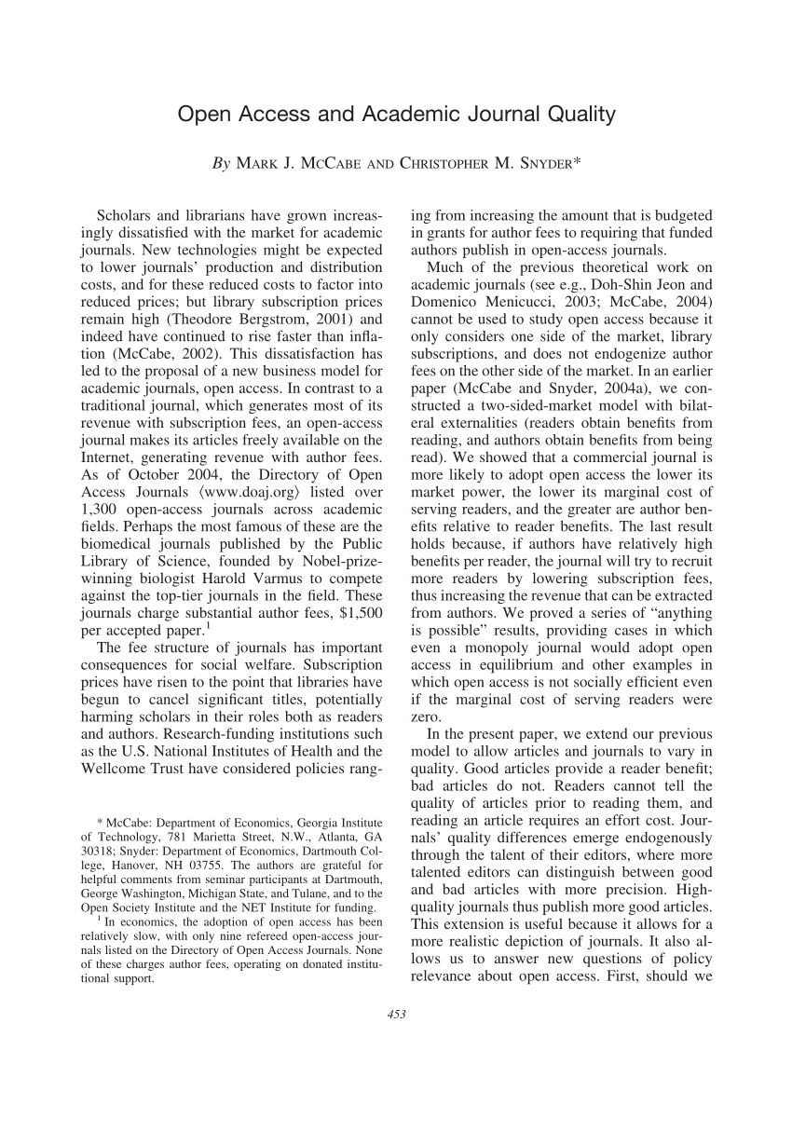
Article
You’ve written an article you intend to submit to an academic journal. Can you copyright it?
YES. An article is an original work in a fixed medium of expression which possesses creativity. Your article is copyrighted the moment you write it.

Slide 9
Copyright Basics – FAQs
What is copyright?
What does it protect?
What does it not protect?
What rights do I have as an author?
How long does copyright protection last?
What is public domain?
Notes:
We wanted to provide you with some scenarios of what can be copyrighted because there is a little bit of a distinction between what copyright can and can’t protect. In this slide, we will talk a little more about the context of what copyright is and what it protects. Because this presentation is focused on author’s rights, we won’t delve too deep into how copyright influences teaching and learning. I wanted to start off this section by stating that I am not a lawyer – this is solely for informational purposes. If you have questions about using copyrighted works, definitely reach out to your subject librarian or UND legal, Jason Jenkins.
What is Copyright? - form of legal protection for original and tangible works both in published and unpublished formats. Any work that has intellectual, creative, or artistic expression, once in a fixed format (or in a format that someone else cannot edit), is protected by copyright.
What does it protect? And not protect? It protects literary, dramatic, artistic, and/or musical works. It does not protect facts, ideas, systems or methods of operation. Copyright is different from patents and trademarks in that patents protect inventions, and trademarks protect a word, phrase, symbol, design or any combination of these.
What rights do I have as an author? Copyright allows you to reproduce the work, prepare derivative works based upon the original work, distribute copies, publicly perform or display the work, and publicly perform sound recordings via digital audio transmission (and an example of this would be that you can broadcast your sound recordings online).
How long does copyright protection last? – It changes a little bit for works published before January 1, 1978 and can depend on many factors. But in most cases, copyright protection lasts for the life of the author + 70 years. If there are multiple authors, it lasts the life of the surviving author + 70 years.
What is the public domain? Work in the public domain is free to use as you wish. Works in the public domain are a little bit older – as of 2019, works published in the US before 1924 or works published before 1964 for which copyrights were not renewed are in the public domain. Renewal was a requirement for works published before 1978. Identifying if works are in the public domain might be important if you wanted to use the public domain work in your own work.
In the next slide we will talk more about why your rights are important.

Slide 10
Why are my rights important?
Right to …
distribute
reproduce works
create derivative works
publicly perform and display
Notes:
Your rights are important because, essentially, you have the right to decide what you do with the work you create and how others can use your work. Once a work is in tangible form, you have many options on what you can do with it. You have the right to distribute, reproduce, create derivative works, and publicly perform or display your work. We’re going to be talking a lot about the right to distribute in this presentation. With the right to distribute, you have the choice in how you make your work accessible and available. You can either choose to publish it commercially or openly available. If you choose to publish it with a traditional publisher, you may run into copyright transfer agreements, which we will talk more about later in this presentation. Essentially, transferring copyright means that you are giving up ownership of your materials and allowing the publishers to do the same things copyright allows you to do. Additionally, with the right to distribute, you also have the right to attach a license to your work if you would like to make it openly available. If you have a spot where you can host your work such as a blog, a university institutional repository, or website, you can attach a license which indicates how others can use your work. A set of licenses frequently used for these purposes are called Creative Commons licenses which we will talk more about later on in the presentation.

Slide 11
Copyright Registration
Work is protected by copyright right away
Registration is voluntary
Fees vary
Notes:
Another commonly asked question about copyright is if you have to register your works. You don’t! It’s completely voluntary. Your work is protected right away once it’s in a tangible format. What registering copyright does is enable you to sure for infringement in the event it occurs. The cost to register your work with the US Copyright Office varies depending on what kind of work you have, but it can range anywhere from 45 – 500 dollars, depending on what item is being registered or what the registration claim is. A common example of where knowing this information is helpful is for graduate students who are writing their dissertation. At UND graduate students submit their theses through ProQuest, who offer the option to register their copyright at the time of submission. It’s good to consider some realistic analysis of what this would actually provide. Dissertations and theses are not works that suffer from frequent infringement – and in the event that someone did start falsely distributing your thesis, as the copyright holder you can file a DMCA takedown request regardless of whether your copyright is registered. Additionally, the ProQuest registration fee is $75 whereas directly registering with the US Copyright Office online is $45 – so even if you do still want to register your work it would be cheaper to do with copyright.gov.

Slide 12
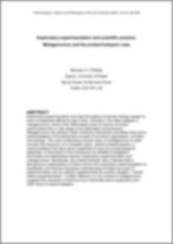
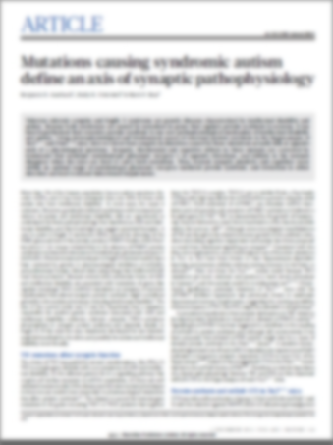
The Publishing Process (Journals)
Copyright Transfer & Publisher Formatting
Original Version
Submitted Version
Peer-Review
Accepted Version
Published Version
Published Version
You own
You own
Publisher owns
Diagram adapted from: ‘Copyright, Publisher Policies, and Authors Rights: An Introduction for ScholarlyCommons Student Interns. Kenny Whitebloom. University of Pennsylvania Libraries. <https://drive.google.com/drive/u/0/folders/0B5PBGPEYJd0xekt0Z3owNWhtSzg>
Notes:
We’ve talked about copyright in general but let’s dive into the specifics. These days the primary method of communicating in academia is through the publication of journal articles. When you publish in a journal, your work goes through various stages, or versions before the final article is out. The first version of your article, the one you submit to the journal for consideration, is sometimes referred to as a preprint. This is what your article looks like prior to any peer-review process or publisher contributions such as technical formatting or copy editing.
If the journal decides that your work looks like something they would want to publish, they send it off for peer-review, where people in your field evaluate your work and suggest revisions. After you make all of the changes from the peer-review process, you have the version of your work that is accepted to the journal. This is sometimes referred to as the “postprint” or, more commonly, the “accepted manuscript”. Pay attention to this version of your article – it’s often the version your journal agreement will permit you the most sharing rights over.
Once your manuscript is accepted by the journal for publication, the publisher will usually require that you sign a Copyright Transfer Agreement and will apply publisher formatting, typesetting, and other design aspects to your article. With this process is complete, your work is published in its final form with all of the publisher applied formatting. This is sometimes called the “publisher PDF” or the “Version of Record”. The language used can very among publishers but at the end of the day they’re all referring to these three versions of your work.

Slide 13
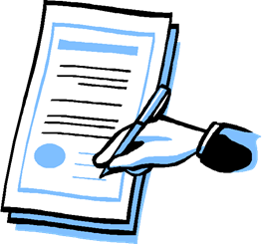
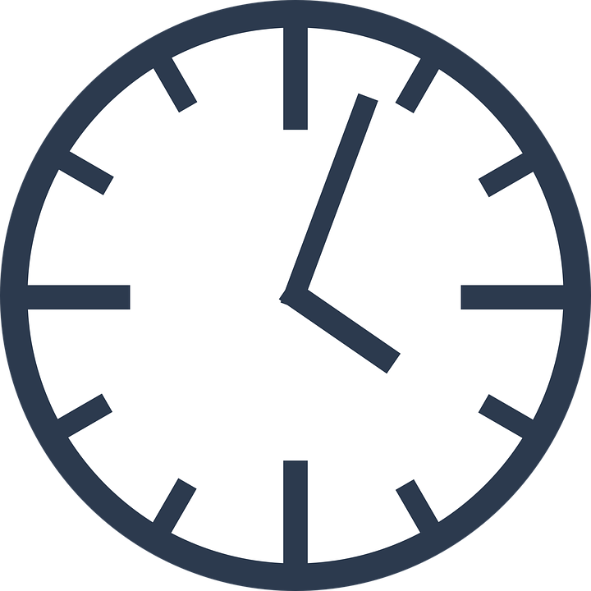
Transfers vs. Licenses
Transfer = Ownership
Give up rights
Needs to be done in writing
Ex. “Copyright Transfer Agreement”
Licenses = Grant of Permission
Can have time limits
Ex. “Creative Commons License”
Diagram adapted from: ‘Copyright, Publisher Policies, and Authors Rights: An Introduction for ScholarlyCommons Student Interns. Kenny Whitebloom. University of Pennsylvania Libraries. <https://drive.google.com/drive/u/0/folders/0B5PBGPEYJd0xekt0Z3owNWhtSzg>
Notes:
So why did I just take you through the different versions of your article created during the publishing process? I mentioned a term that some of you may not be familiar with – a copyright transfer agreement. Most major publishers will require you to sign one of these before they formally publish your paper. Since you are the author, you have the option to give away certain rights to certain people and retain rights for yourself. Publishers typically ask that you transfer all your rights over to them, and they, in turn, will give certain rights back to you. When you transfer your copyright, though, you no longer own rights over the work. Unless addressed in the contract, this can affect your ability to do a number of things with your work such as:
sharing it on a repository or academic sharing website
copy the work for distribution to students
giving permission for other faculty and students to use your work in their courses
Given this, it’s important that you read your publishing agreement to see what rights you’re signing away -- and, ideally, to negotiate changes to the agreement before signing if there are rights you wish to retain. Keep in mind, too, that transferring your copyright is not NEEDED to publish your work. If the publisher was willing, a similar contract could be signed where they license your work instead. A license is a legal agreement that grants another body certain specified permissions, without transferring the copyright that gives you the right to negotiate the license to start with. Nevertheless, copyright transfer agreements remain common industry practice, so we’re going to go through a few sample contracts from major academic publishers so you can see what they look like.

Slide 14
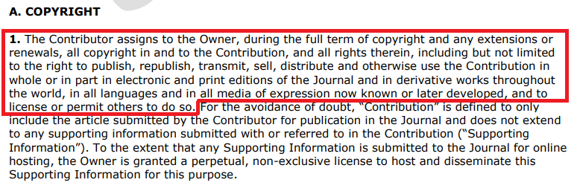
Copyright Transfer (Wiley)
Excerpted from: https://authorservices.wiley.com/asset/Copyright-Transfer-Agreement-Sample.pdf
Notes:
This distinction between transfer and licensing shows up in publishing contracts. Note this section from a sample author agreement with Wiley, transferring copyright from the author to Wiley.
“1. The Contributor assigns to the Owner, during the full term of copyright and any extensions or renewals, all copyright in and to the Contribution, and all rights therein, including but not limited to the right to publish, republish, transmit, sell, distribute and otherwise use the Contribution in whole or in part in electronic and print editions of the Journal and in derivative works throughout the world, in all languages and in all media of expression now known or later developed, and to license or permit others to do so. For the avoidance of doubt, “Contribution” is defined to only include the article submitted by the Contributor for publication in the Journal and does not extend to any supporting information submitted with or referred to in the Contribution (“Supporting Information”). To the extent that any Supporting Information is submitted to the Journal for online hosting, the Owner is granted a perpetual, non-exclusive license to host and disseminate this Supporting Information for this purpose.”

Slide 15
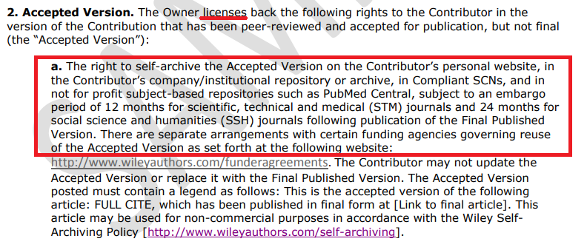
Copyright Transfer (Wiley)
Excerpted from: https://authorservices.wiley.com/asset/Copyright-Transfer-Agreement-Sample.pdf
Notes:
Further in the contract, Wiley licenses back to you the right to share your accepted manuscript on an institutional repository after an embargo period. You remember how I mentioned that the accepted manuscript of your article is a version you want to make sure you preserve? [read excerpt here] Wiley is not unique in specifying your rights to share or self-archive your work apply to the accepted manuscript rather than the final published version.

Slide 16
Copyright Transfer
(Taylor & Francis)
Notes:
Taylor and Francis is another major academic publisher that asks you to transfer your copyright to them prior to publication.

Slide 17
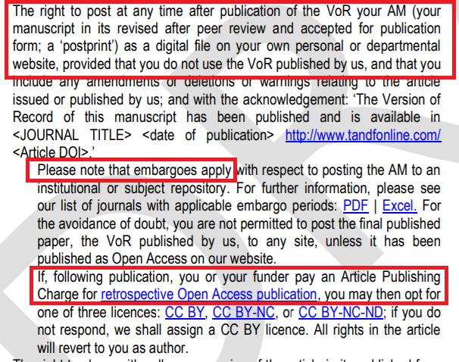
Copyright Transfer
(Taylor & Francis)
Notes:
Again, like Wiley, they permit you to share your accepted manuscript but NOT the version of record on a repository. They also require an embargo period, meaning a set amount of time – usually somewhere between 6 – 24 months – must pass before you are legally permitted to make your accepted manuscript openly available.

Slide 18
Author Addendum
SPARC Author Addendum is a free legal instrument that modifies the publisher’s agreement.
The Scholar’s Copyright Addendum Engine is an addendum creation tool where you can pick how many rights you want to include.
For more options see the Author’s Rights Research Guide: https://libguides.und.edu/author-rights
Notes:
Some of this might seem overwhelming, especially if you’re new to academic publishing. It’s a lot of legalese to parse just to figure out whether you’ll be able to share an article that you wrote! Fortunately there are tools out there to help you protect your rights. Let’s say you’ve looked at the publication agreement your publisher has offered you and you’re not sure whether it will let you retain a right you’re concerned about. Remember that you don’t have to sign the first agreement presented you! Journal contracts are like job contracts that way – there’s room for negotiation. If you know there are particular rights you want to retain for yourself that you don’t see accounted for in the journal’s standard publishing agreement, you can suggest an author addendum to the contract. [go through examples]

Slide 19
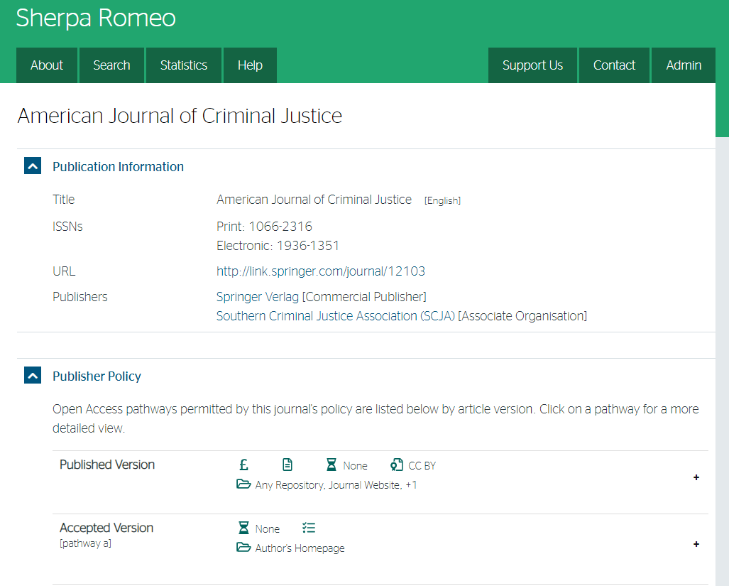
Sherpa Romeo
Notes:
Reading and negotiating your publishing contract is important but let’s be honest – if you’ve published already odds are you did not look at it in detail or keep a copy for reference. How do you figure out what rights you still have now? I want to show you Sherpa Romeo, a database focused on tracking journal publishers’ open access policies. [demo Sherpa Romeo with link to record for the American Journal of Criminal Justice] One thing to note is that Sherpa Romeo is a volunteer run resource – its’ coverage is very good but not comprehensive. If you have a publication that you can’t find there and no longer have your agreement for you can contact your publisher directly. The library also offers a rights checking service tied with our institutional repository – if you’re trying to figure out whether you can share an article you’ve already published you can send us the citation and we’re happy to look into the rights situation on your behalf.

Slide 20
Scenarios: Importance of Protecting your Rights
Your decision to
Provide copies to your class
Host on platforms of your choice
Publisher is no longer publishing
Notes:
We wanted to provide you with a couple of different scenarios of why it might be important to protect your rights. The first example we wanted to talk about deals with the right to distribute – with this right you have the option to provide copies to your class. This is a good thing to keep in mind if you know that the library doesn’t subscribe to the journal you typically publish in. With the right to distribute, you also have the right to host on platforms of your choice. I wanted to spend a little bit of time talking about a situation that happened back in 2013. Elsevier issued a large amount of takedown notices, targeting platforms like academia.edu and ResearchGate, essentially telling authors they were not able to host the article they published on those platforms. By signing that copyright transfer agreement, authors were agreeing to let Elsevier determine how that work got distributed. I could imagine that this would be very frustrating as an author; choosing where you can post your work is a huge benefit, and it might be important to keep this in mind when working with publishers. Another example of why protecting your rights is important is increasing your options should the publisher stop publishing. This tends to be more of an issue with book publishing. Should your book publisher go out of print, or stop selling as well as it used to, and you want your work to continue to make an impact, you can consider what’s called rights reversion. This allows you to gain back some or all of your copyrights. A rights reversion is a clause in the contract that allows you to gain back some or all of the rights to your work. It might be difficult to know where to start if you’re interested in rights reversion, but thankfully there are some resources available. The Authors Alliance provides documentation on understanding the process of Rights Reversion.

Slide 21
Benefits of Open Access
More downloads potentially equals more readership
Citation count important for author’s impact in scholarly community
OA citation advantage supported for different disciplines
Many factors play in Open Access Citation Advantage (OACA)
Notes:
On that same theme of protecting your rights – with the right to distribute you also have the option of choosing to make your work openly available. One benefit of choosing to make your work open access is that there can potentially have higher readership.
Open access articles may receive more citations, downloads, and readership – assuming if everyone that downloads the article, reads it as well. Considering to make work open access has an advantage because work isn’t going to be behind a paywall – anyone that wants to access the material, regardless of affiliation, can do so. This means the work that has been published open access can reach more people and further contribute to the scholarly community. Citation count is important because this influences how much impact an author has had in their field. The more citation counts, the more it shows this work has had an impact in the discipline and is used to further advance research in that area.
I wanted to note that there are some factors influence how OA articles might receive a greater citation advantage. Some authors might choose to publish some of their best work as OA articles, it might also depend on discipline, and it might also depend on which Open access option you choose. If you have questions on Open Access, please check out the recording or slides for the presentation on Open Access we offered in October. You can also reach out to your subject librarian if you have questions on open access..

Slide 22
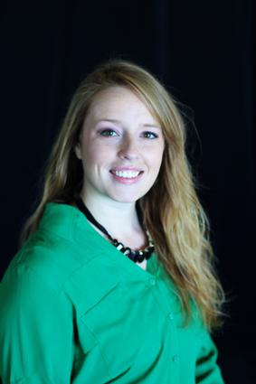
Author Testimonies
Greater citation/impact of work among other scholars
Greater impact/ reach with non-scholars
RaeAnn Anderson, Psychology, UND
Notes:
Don’t just take our word for it on these benefits! Today we invited RaeAnn Anderson, a faculty member at UND who has exercised her own rights of distribution by sharing several of her papers on the UND Scholarly Commons. Unfortunately she was unable to make it today due to a family emergency, so we’ve included some comments she’s made on the benefits she has seen in making her work openly available.
Greater citation/impact of work among other scholars
Greater impact/ reach with non-scholars
She also mentioned that a professional had found her work on the UND Scholarly Commons and connected with her via twitter. This professional might not have otherwise had access to their literature if it hadn’t been openly available. Connecting with a broader range of researchers and professionals can also be a great benefit of choosing to make work open access.

Slide 23
Creative Commons Overview
What is Creative Commons?
What are the Creative Commons license?
Is Creative Commons against copyright?
Why are CC license important to know about?
Notes:
I mentioned CC licenses at the beginning of this presentation, and I wanted to spend a little time talking about Creative Commons. I would guess that many folks here have heard about creative commons before, but to provide a little bit of an overview, here are some frequently asked questions and some context on why it might be important to know about CC licenses.
What is creative commons? Creative commons is a global nonprofit organization that is dedicated to helping creators share and reuse work. In addition to provided copyright licenses CC offers other legal and technical tools to help facilitate sharing and discovery of creative works. A common example of other work that creative commons has done is the Public Domain mark that is used to mark if a work is in the worldwide public domain.
What are creative commons licenses? These are copyright licenses that can be attached automatically to all creative material under copyright. There is no single creative commons license, rather there are six licenses that allow users to do different things. Some are more open than others, and we will provide more information about the rights to cc licenses and what the six licenses are in the next couple of slides.
Is creative commons against copyright? Nope! Simply put, creative commons license are copyright licenses.
Why are CC licenses important? CC licenses can be applied to any type of work – educational resources, music, photographs, and many other forms of work. The licenses are important to note if you wish to make your work more openly available. You get to decide how your work is reused, and the license are indications of how others can use your work.
I also wanted to make a quick note that when you attach a creative commons license to something, it cannot be revoked. This means that it lasts the duration of copyright. This is just important to note when you are choosing a creative commons license – carefully consider how you want to make your work open.

Slide 24
CreativeCommons 2018
sparcopen.org
Notes:
There are four “rights” with creative commons licenses that you allow users to do. Choosing which label depends on how restrictive you want to be. The first right I wanted to talk about is the attribution by – this means that you give users the ability to copy, distribute, display, perform, and make derivative works based on it only if they attribute you as the original author. The share-alike means that adaptations must be shared under the same terms as the original work. The NonCommerical right means that individuals can use, adapt remix or build upon the material as long as they do not try to sell the material. And finally, the Noderivative means that people who want to use your work cannot adapt or create a derivative of the original work. These are essentially the terms of the license that indicate how others can use what you create.

Slide 25
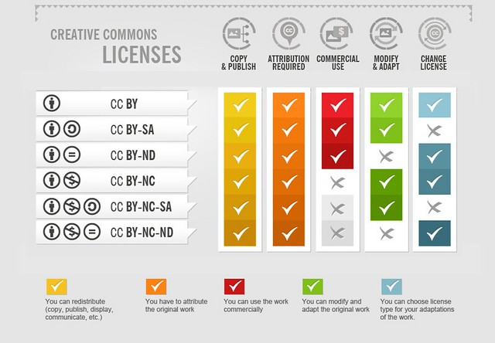
Six Creative Commons Licenses
"How to Attribute Creative Commons Photos" by Foter is licensed under CC BY-SA 3.0
Notes:
This infographic provides an overview of what each of the six creative commons license allows you to do. The CC BY is the most open, allowing people to copy, provide attribution, modify/adapt, and change the license. Then it starts to get a little more restrictive with each license, and finally, the CC BY-NC-SA and CC BY-NC-ND are the most restrictive. You don’t have to worry about memorizing this information. The library has resources to help you navigate Creative Commons license. If you would like to know more about CC licenses, definitely connect with your subject librarian!

Slide 26
Creative Commons Activity
Create something of your choice
Attach a creative commons license
Which one did you choose and why?
Creative Commons
Choose a Creative Commons License
Notes:
I wanted to recreate an activity I participated in during a creative commons workshop. This activity helped frame what I can do with my copyrights and how I want others to use this work I created.
The first step is to create something – it can be anything you want to. Simply take a photo or video, draw something that makes you feel good, or write a short story (could be two sentences) and then attach a Creative Commons license to it. And our question to you is, which license did you choose and why? You can either type this into chat or unmute yourself.
Before starting the activity, I wanted to mention that Creative Commons has a tool to help authors select which license they would like to attach to their work. We will be making the slides and recording for today’s presentation available to participants, and this is a tool that we would also use to help determine which license we would want to use.
[demo the selector tool with this workshop as the work planning to be shared]

Slide 27
Resources @ CFL
CFL Research Guides
Copyright Basics Guide
Author’s Rights Guide
Open Access Guide
Notes:
The last thing we wanted to leave you with is links to further resources on this topic. We have three research guides relevant to the subjects we discussed today: our copyright basics guide, our author’s rights guide, and our open access guide. All of these can be found on the library website by searching our list of research guides or clicking through these links once we’ve sent you this Powerpoint.

Slide 28
Have questions?
Zeineb Yousif
(Digital Initiatives Librarian) zeineb.yousif@und.edu
Brittany Fischer
(Social Sciences & Scholarly Communication Librarian) brittany.fischer@und.edu
CFL Subject Librarians
Ask Us reference@library.und.edu
Jason Jenkins
(UND Office of General Counsel) jason.jenkins@und.edu
Speaker notes will also be available with the PowerPoint slides
Notes:
That concludes our content for today’s workshop! Questions?

Slide 29
Image Credits
Screenshot of Brussel Sprout Caesar Salad Recipe from TheKitchn: https://www.thekitchn.com/brussels-sprouts-caesar-salad-22948882
Screenshot of photos from The University Archives Photograph Collection: https://commons.und.edu/archive-photos/
Screenshot of article abstract page from ResearchGate: https://www.researchgate.net/publication/23503956_Open_Access_and_Academic_Journal_Quality
How to Attribute Creative Commons Photos" by Foter

Slide 30
References
Crews, Kenneth D, ProQuest. Copyright and your dissertation or thesis: Ownership, fair use, and your rights and responsibilities. (2013). https://www.uwyo.edu/research/_files/docs/proquest_copyright_and_your_dissertation_or_thesis.pdf
U.S. Copyright Office. “Chapter 11: Subject Matter and Scope of Copyright”. Copyright Law of the United States (Title 17). https://www.copyright.gov/title17/92chap1.html
U.S. Copyright Office. Fees. https://www.copyright.gov/about/fees.html
ProQuest. Do I have to copyright my dissertation/thesis? https://support.proquest.com/s/article/Do-I-have-to-copyright-my-dissertation-thesis?language=en_US
Fortney, K. (2013). Elsevier takedown notices for faculty articles on UC sites. Office of Scholarly Communication, University of California. https://osc.universityofcalifornia.edu/2013/12/elsevier-takedown-notices/
Author’s Alliance. Rights Reversion. https://www.authorsalliance.org/resources/rights-reversion-portal/
Creative Commons. Frequently Asked Questions. https://creativecommons.org/faq/

